Slide 1

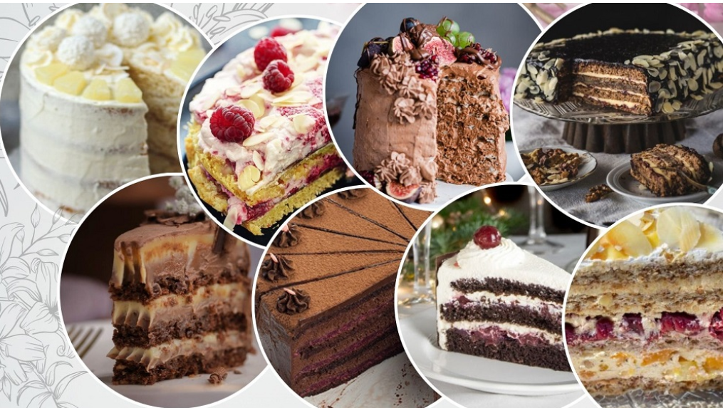
Danas ćemo
pričati o
Ukusno putovanje kroz globalne vrste kolača
Notes:
Image source: AI-generated

Slide 2

Klasična čokoladna torta
Notes:
Rich Chocolate Flavors and Ingredients, Popular Recipes and Variations

Slide 3
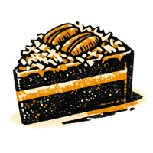
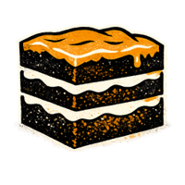
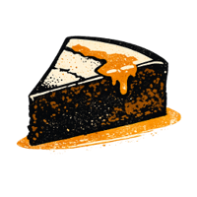
Popularni recepti i varijacije
Njemačka čokoladna torta Ključni sastojci: čokolada, kokos, pekan orasi. Tekstura: Gusta, vlažna. Porijeklo: Njemačka; popularizirana u SAD-u.
Američka torta sa slojevima Ključni sastojci: kakao, maslac krema, ganache. Tekstura: Pahuljasta, lagana. Porijeklo: Sjedinjene Američke Države.
Čokoladna torta bez brašna Ključni sastojci: čokolada, jaja, maslac. Tekstura: bogata, fudgy. Porijeklo: Evropa; Bez glutena.
Notes:
Classic chocolate cake recipes vary globally, ranging from the dense German chocolate cake featuring a coconut-pecan frosting to the fluffy American-style chocolate layer cakes with buttercream or ganache fillings. Variations include flourless chocolate cakes, which cater to gluten-free diets, and molten lava cakes known for their liquid chocolate centers. Furthermore, vegan and sugar-free options have surged in popularity, using substitutes like avocado, applesauce, or alternative sweeteners to meet dietary preferences without sacrificing richness. Image source: AI-generated

Slide 4
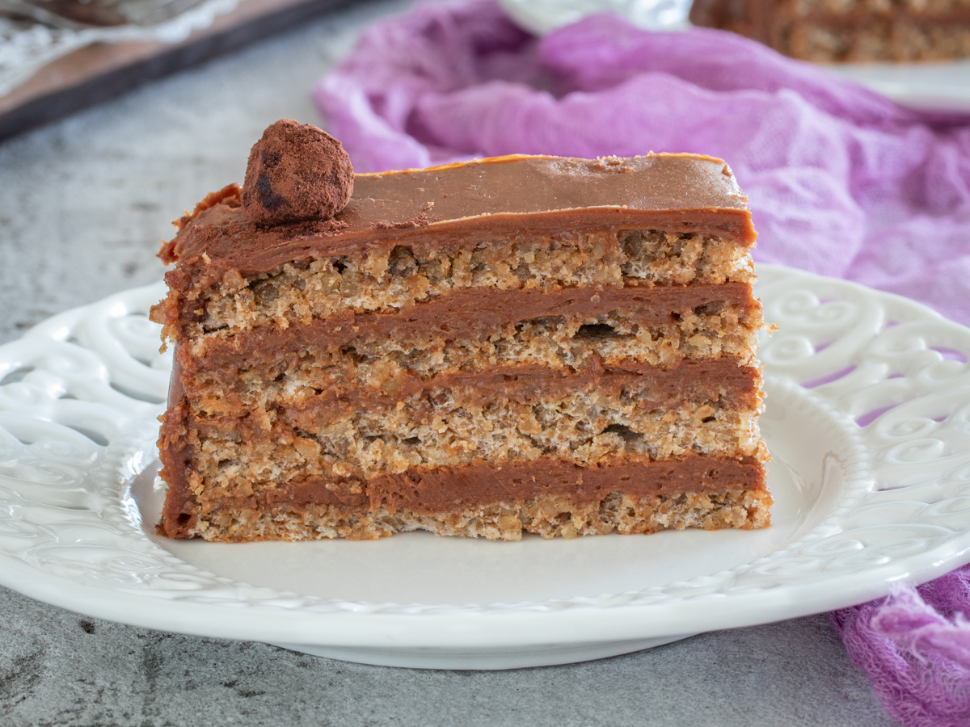
Reforma torta
Orasi
Jaja
Čokolada
Puter

Slide 5
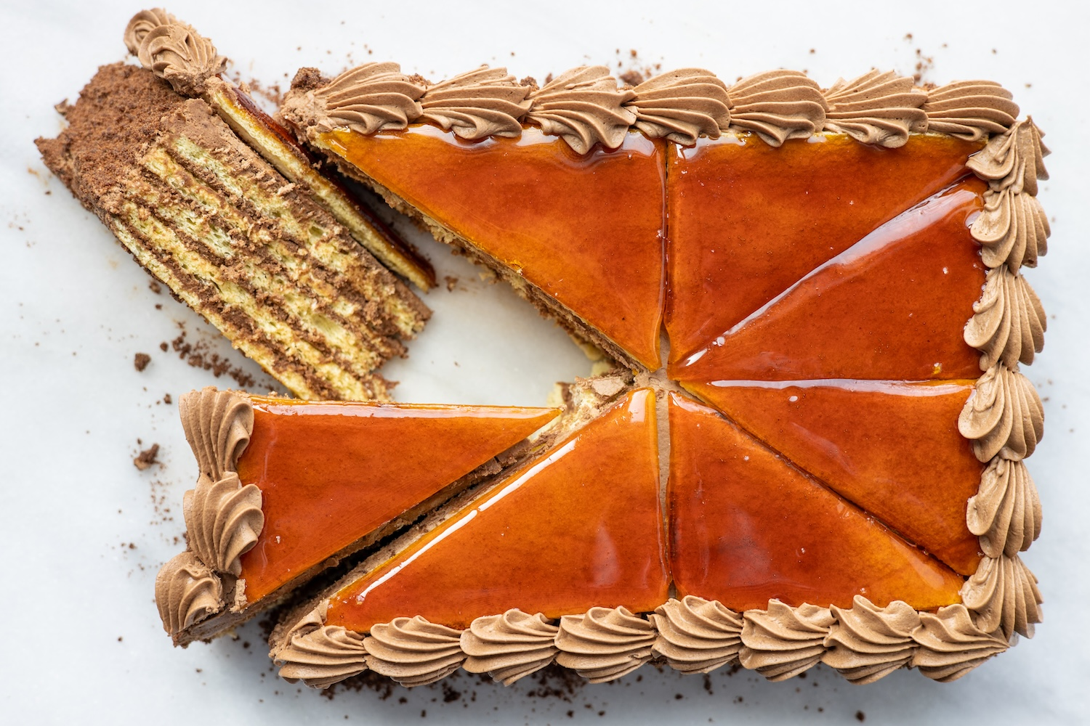
Doboš torta
Pržen sećer

Slide 6
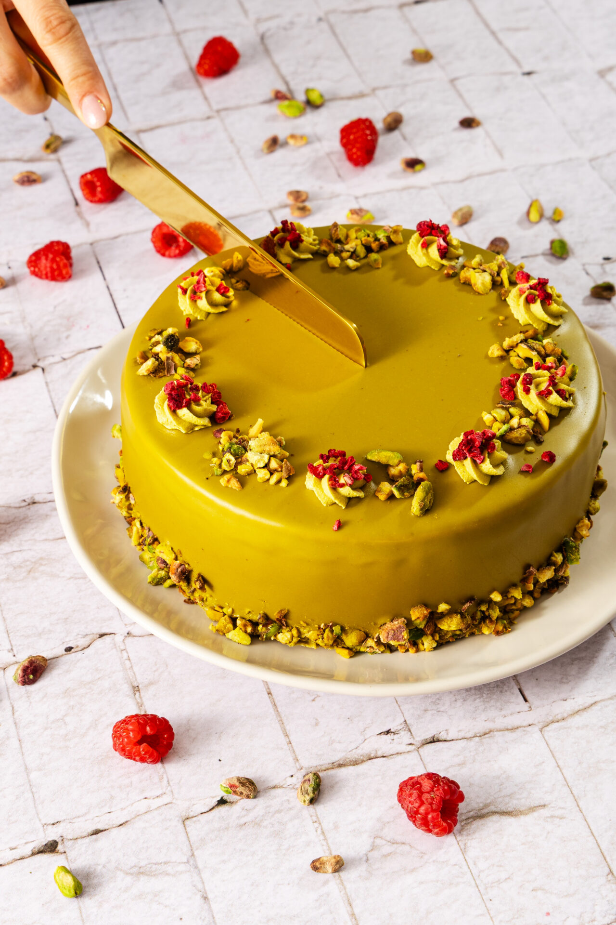
Dubai torta

Slide 7
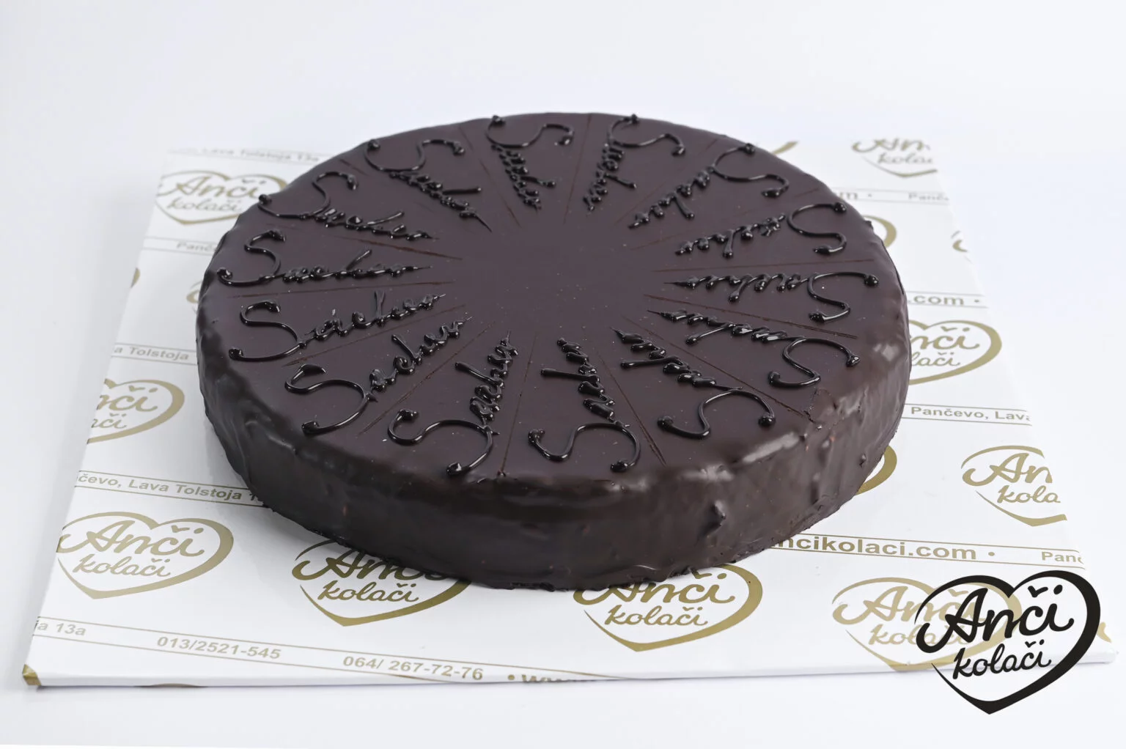
Saher torta

Slide 8
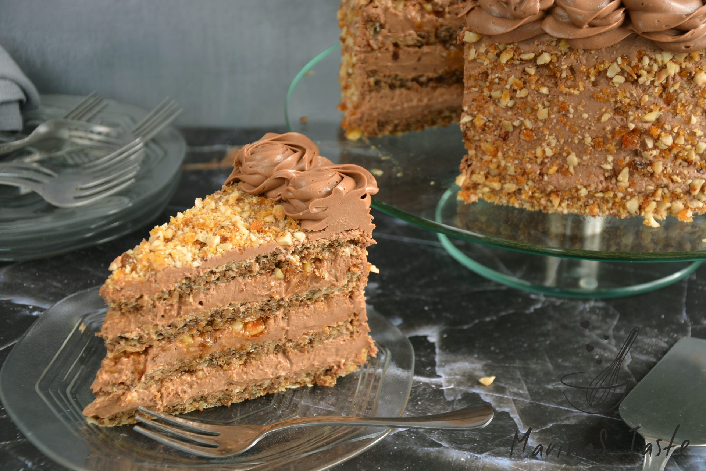
Grilijaš torta

Slide 9
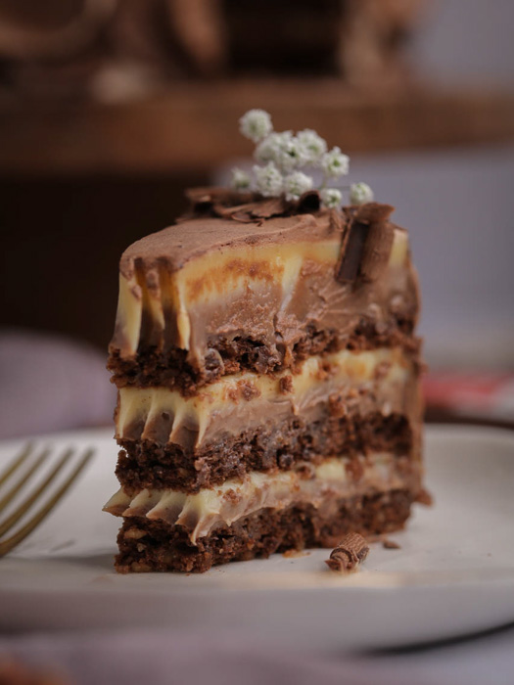
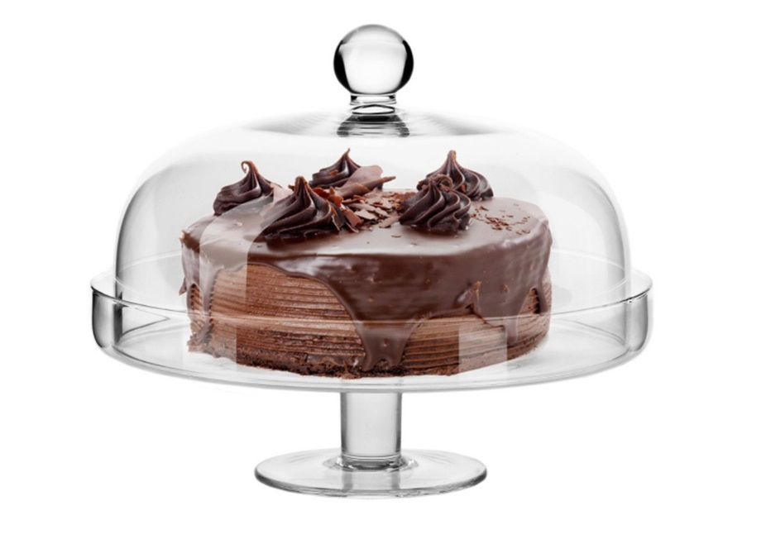
Boem torta

Slide 10
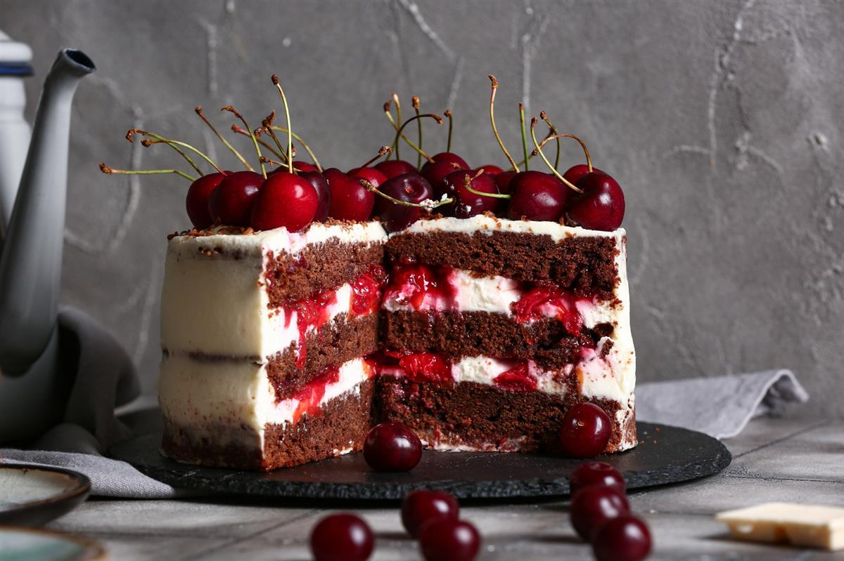
Švarcvald torta - black forest- crnagora

Slide 11
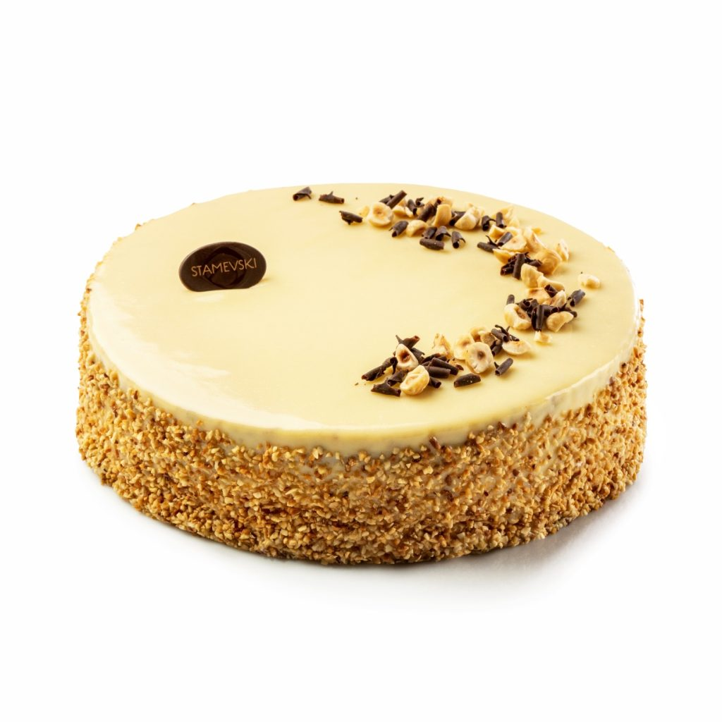
Spanski vetar
Kombinacija Lešnik kora, vanil krema sa dodatkom lešnika, pusla i komadićima čokolade prelivena belom glazurom.

Slide 12
Tradicionalni vanila biskvit
Patišpanj: jaja šećer brašno
Notes:
Light and Airy Texture, Common Uses for Celebrations

Slide 13
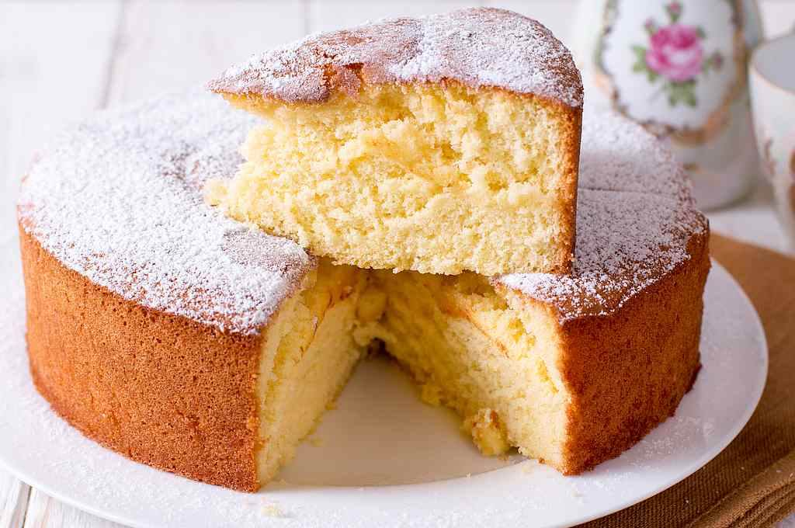
Pan de Espana
5 celih jaja
5 kašika šećera
5 kašika brašna
1 prašak za pecivo

Slide 14
Top 3
Patišpanj je među tri najtraženije podloge za formalne proslave širom svijeta, cijenjen zbog svestranih kombinacija i široke privlačnosti gostiju.
Notes:
Vanilla sponge cake's neutral flavor and adaptable structure make it a popular base for wedding cakes, birthday cakes, and other celebrations worldwide. It pairs well with diverse fillings like fruit preserves, mousses, and buttercream frostings. Its ability to absorb syrups allows bakers to infuse additional flavors such as liqueurs or fruit juices, enhancing moistness and taste. According to bakery industry reports, vanilla sponge frequently ranks among the top three cake bases chosen for formal events due to its versatility and wide acceptance.

Slide 15
Voćna torta
Notes:
Fresh Strawberries and Cream, History and Regional Variations

Slide 16
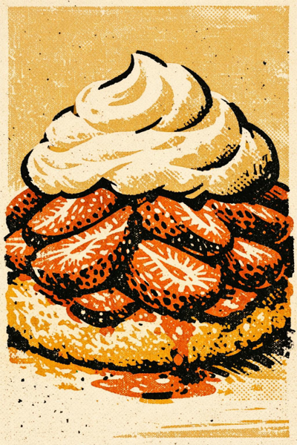
Sveže jagode i šlag
Kvalitet sastojaka Zrele jagode donose prirodnu slatkoću i svijetlu kiselost, balansirajući bogatstvo vrhnja.
Kontrast teksture Šlag, teška ili zgrušana pavlaka dodaje glatki luksuz na laganoj bazi od keksa ili patišpanja.
Notes:
Strawberry shortcake prominently features fresh, ripe strawberries which provide natural sweetness and acidity, balancing the richness of the cream. The use of whipped heavy cream or clotted cream adds a smooth, luxurious texture that complements the light biscuit or sponge base. Seasonality greatly affects flavor intensity; hence, the best shortcakes are made during strawberry harvest months when fruits have the highest sugar content. Nutritional data indicates strawberries are rich in vitamin C and antioxidants, adding a healthful dimension to this indulgent dessert. Image source: AI-generated

Slide 17


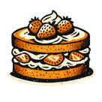
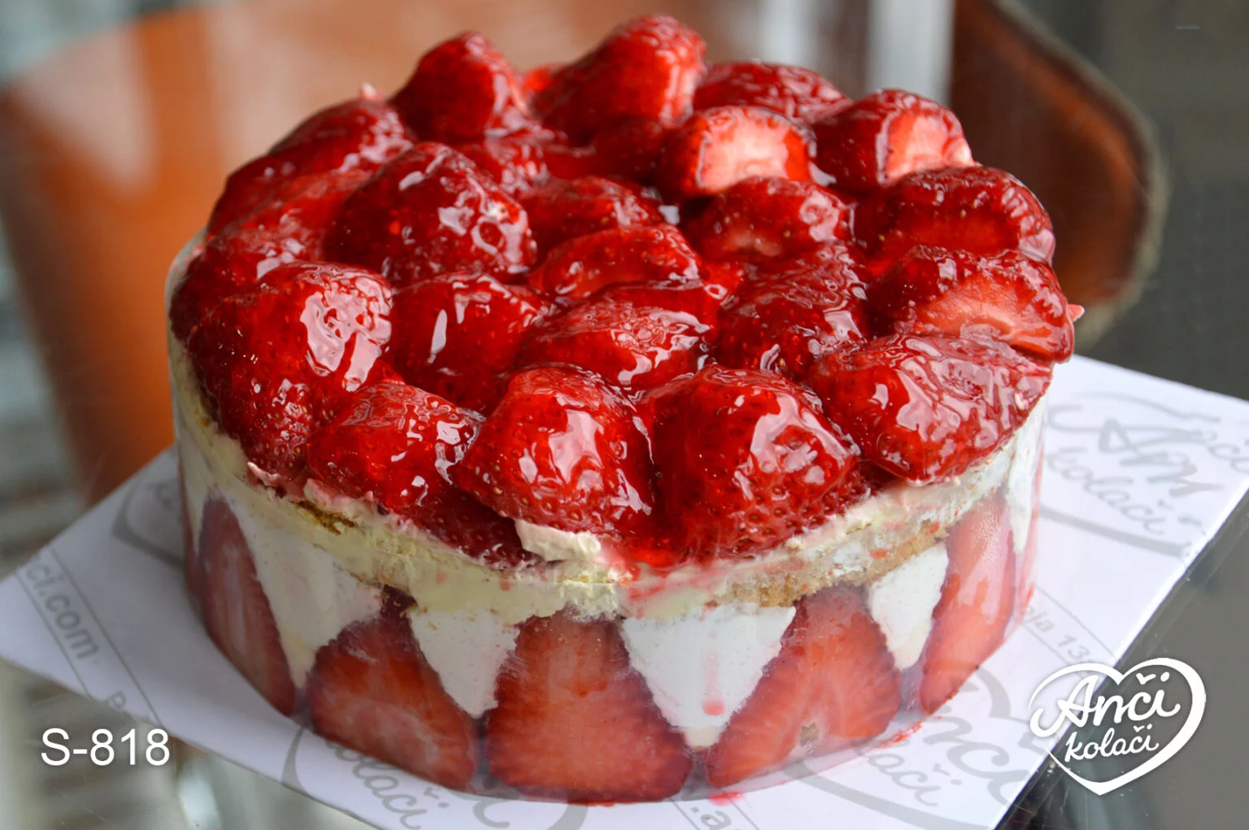
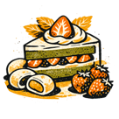
Istorija i regionalne varijacije
Sjedinjene Države Porijeklo: Amerika 19. stoljeća. Ključne karakteristike: Baza u stilu keksa, narezane jagode, šlag. Profil okusa: Bogat, maslacast i kremast.
Ujedinjena Kraljevina Porijeklo: Evropa 16. stoljeća. Ključne karakteristike: Slojevi biskvita, jagode, vrhnje. Profil okusa: Lagan, prozračan i suptilno sladak.
Japan Porijeklo: Moderna adaptacija. Ključne karakteristike: Mochi i elementi s dodatkom matche, jagode, šlag. Profil okusa: Žilavo, zemljano i svježe.
Srbija
Može da se jede kašikom
Notes:
The strawberry shortcake has its roots in 16th-century Europe, evolving differently across regions. In the US, it often features a biscuit-style base with sliced strawberries and whipped cream, while British versions may use sponge cake layers. Japanese variations include mochi and matcha-infused elements combined with strawberries. This regional diversity illustrates adaptation to local tastes and available ingredients while retaining the core concept of fresh berries with cream and cake or biscuit. Historical sales data reflect its popularity spike during summer months in western countries. Image source: AI-generated

Slide 19
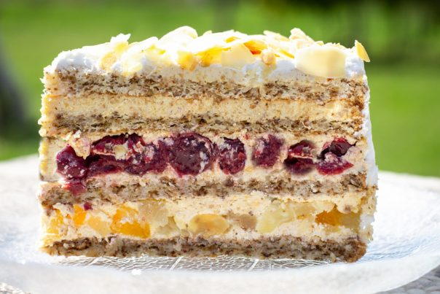
Moskva torta – sa višnjama

Slide 20
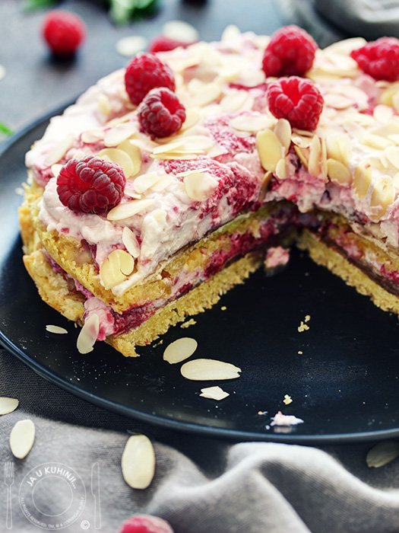
Sa malinama
Maline
Maskarpone
Šećer
Sok-mleko
Piškote

Slide 21
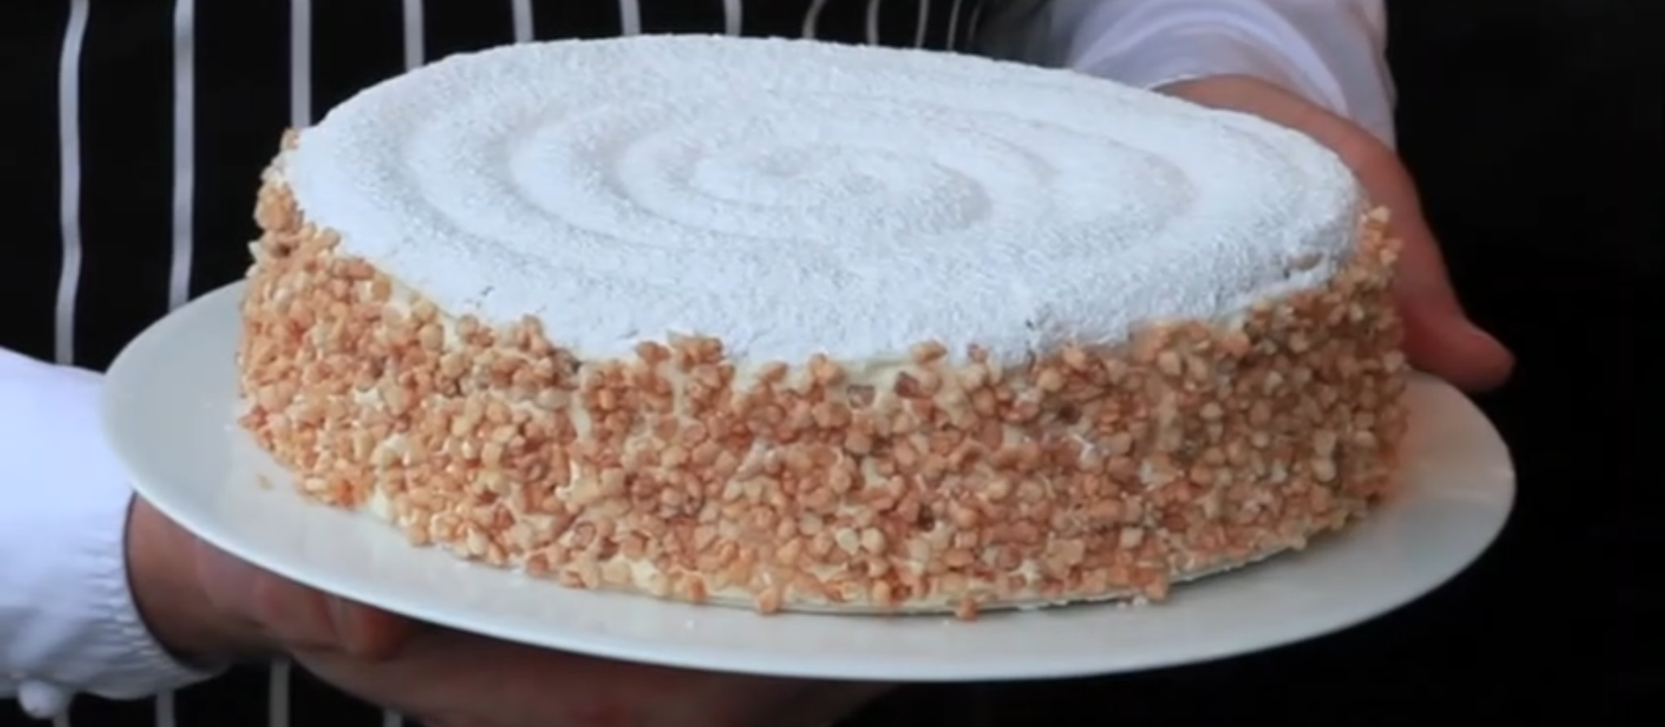
Le Notre – Pariz – Success torte

Slide 22
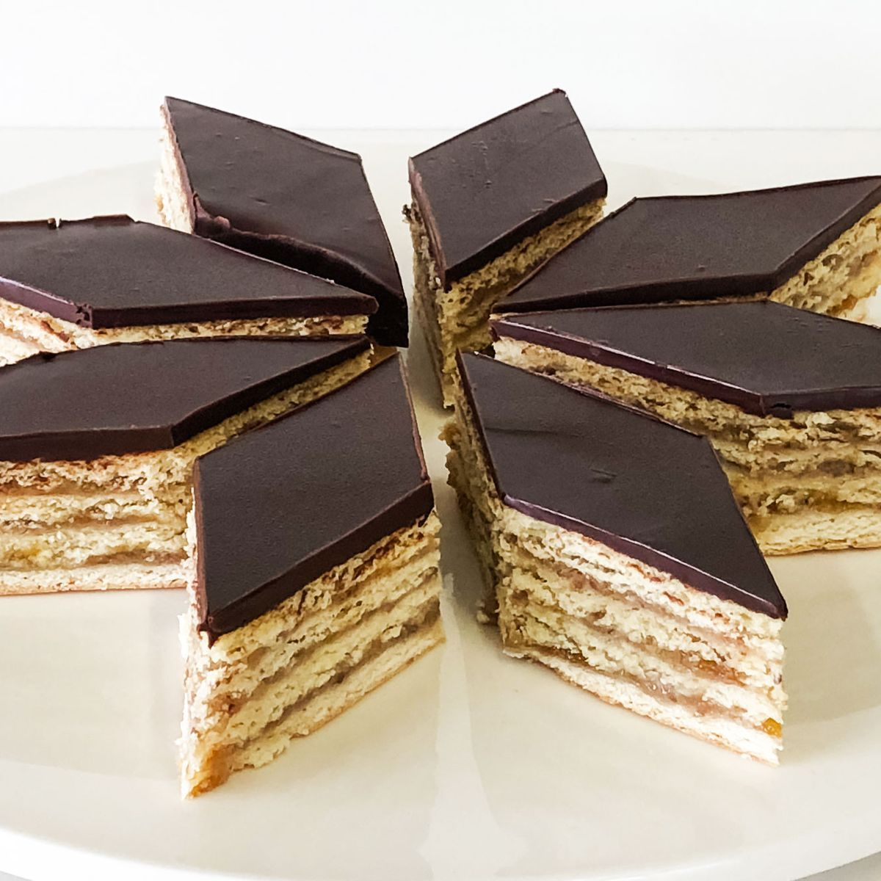
Zserbo
GERBEAUD
Budapest

Slide 23
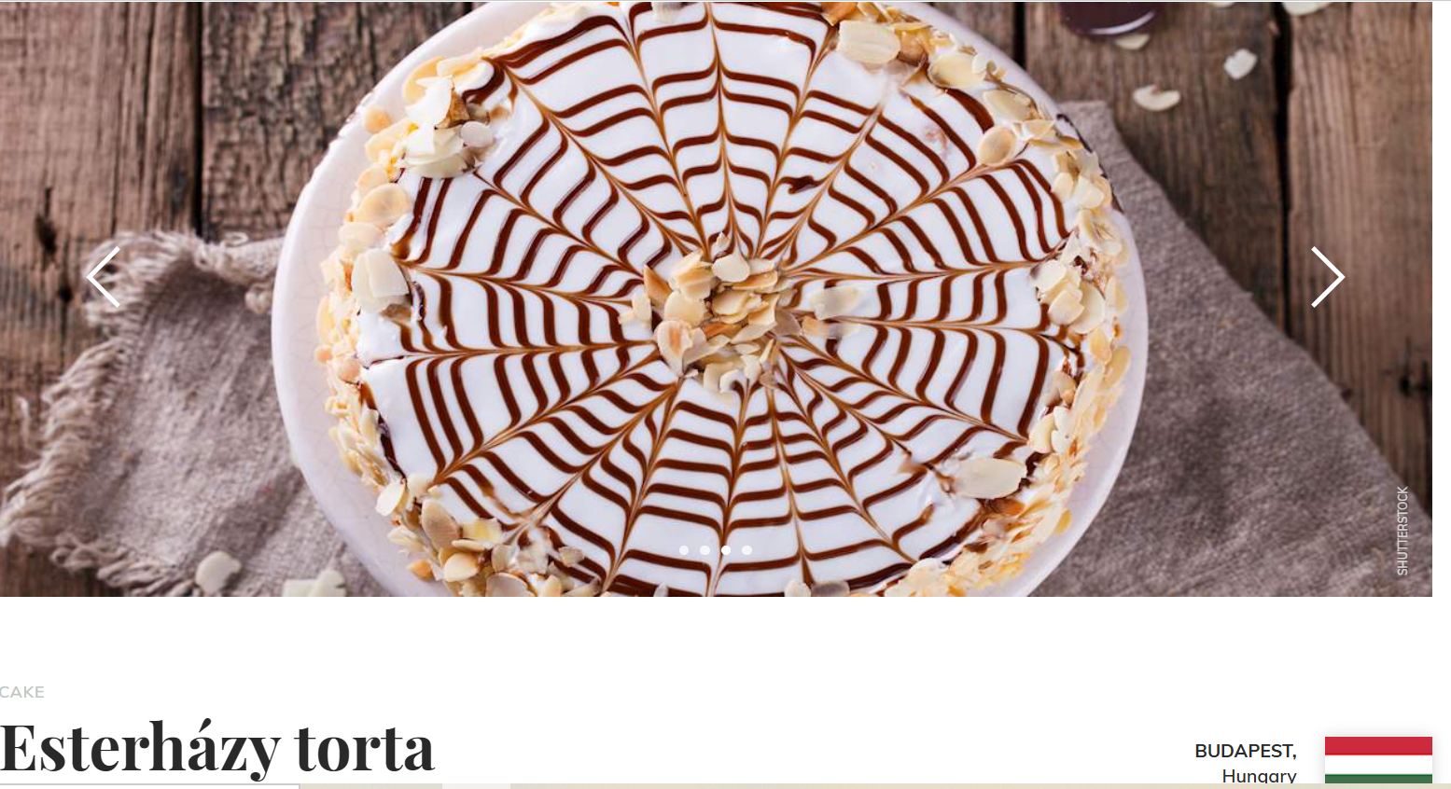
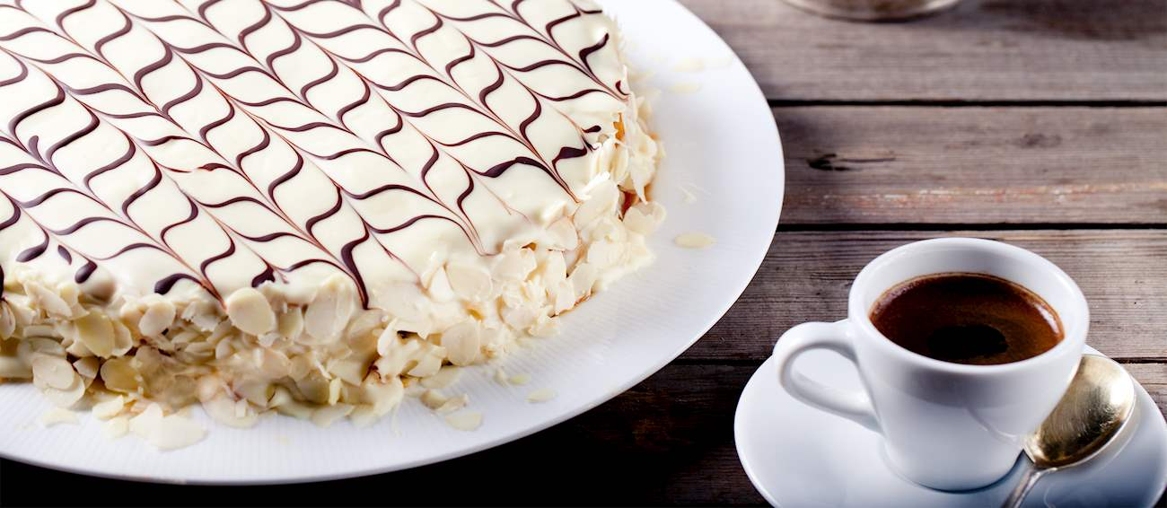
Esterhazi

Slide 24
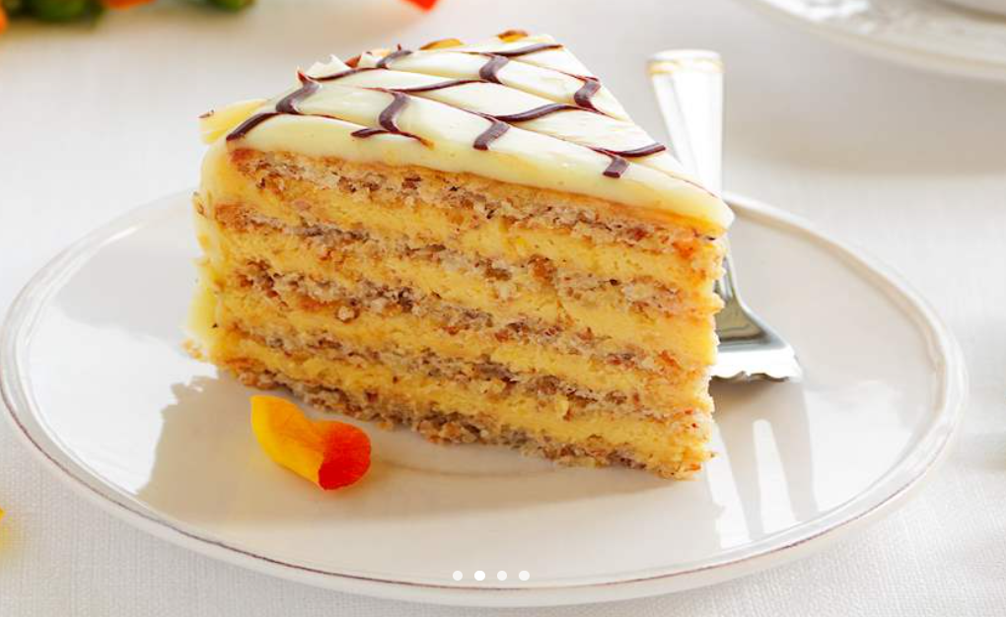
Esterhazi
Tradicionalno, Esterházy torta se sastoji od nekoliko slojeva bademove beze i bogate vanilije puter kreme sa dodatkom konjaka, iako se u modernim verzijama bademi često zamjenjuju orasima ili lješnjacima. Torta je prekrivena bijelim fondant glazurom i ukrašena čokoladom u stilu paukove mreže ili chevron mramora.

Slide 25
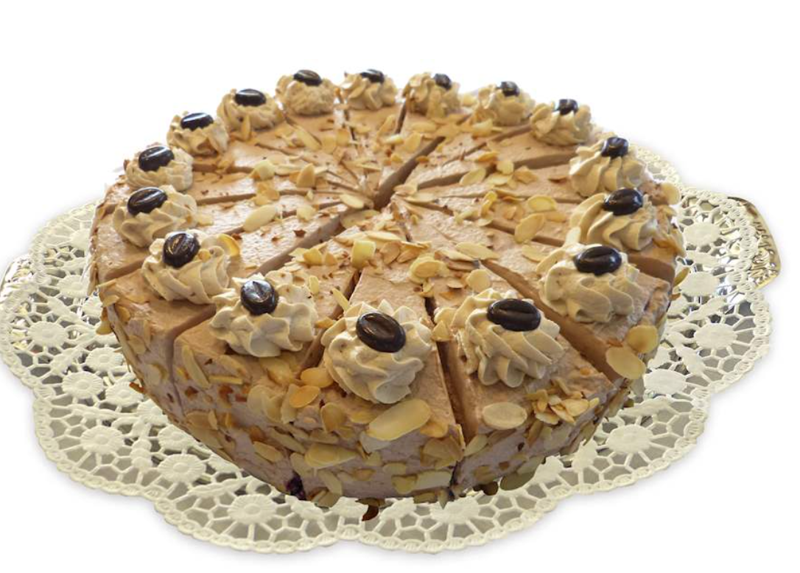
MOKA

Slide 27
Slojeviti Red Velvet Cake
Distinctive Color and Flavor, Cream Cheese Frosting and Presentation
Notes:
Distinctive Color and Flavor, Cream Cheese Frosting and Presentation

Slide 28
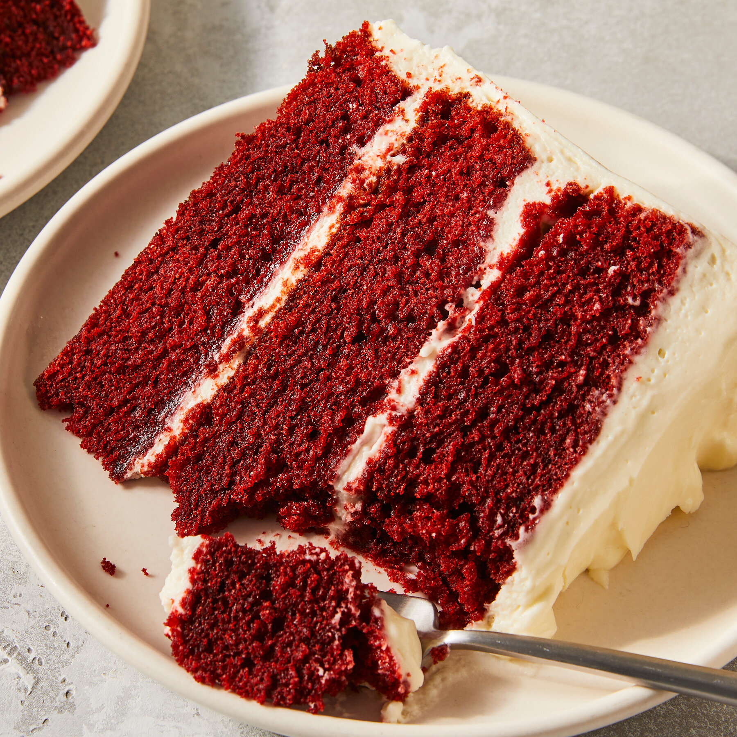
Prepoznatljiva boja i ukus
Hemija boja Prirodni kakao reaguje sa kiselim mlaćenicom i sirćetom, pojačavajući tonove crvenog antocijanina; Moderni recepti često pojačavaju to bojama za hranu. Kontrolisana kiselost čuva nijansu tokom pečenja i održava mrvice vizuelno živopisnim.
Profil okusa Blagi kakao donosi suptilne čokoladne note uravnotežene blagim kiselinskim efektom. Krem sir dodaje mliječnu slatkoću i so, zaokružujući gorčinu i pojačavajući dubinu kakaa.
Vlažna, nježna tekstura Mlaćenica, ulje i emulgatori smanjuju čvrstoću glutena i zadržavaju vlagu za fine mrvice. Ova mekana struktura, u kombinaciji sa upečatljivim bojama, čini da torta ima trajnu pekarsku privlačnost.
Hemija i ukus u red velvet torti
Notes:
Red velvet cake is renowned for its deep red color, traditionally derived from a reaction between natural cocoa powder and acidic ingredients like buttermilk and vinegar, though food coloring is commonly added today. Its flavor profile blends mild cocoa notes with a subtle tang from the vinegar and buttermilk, differentiating it from typical chocolate cakes. Studies indicate that the texture is moist and tender, owing to the unique combination of ingredients and emulsifiers used. The cake's vibrant color also gives it a visual appeal that has fueled its popularity in modern bakeries. Image source: AI-generated

Slide 29
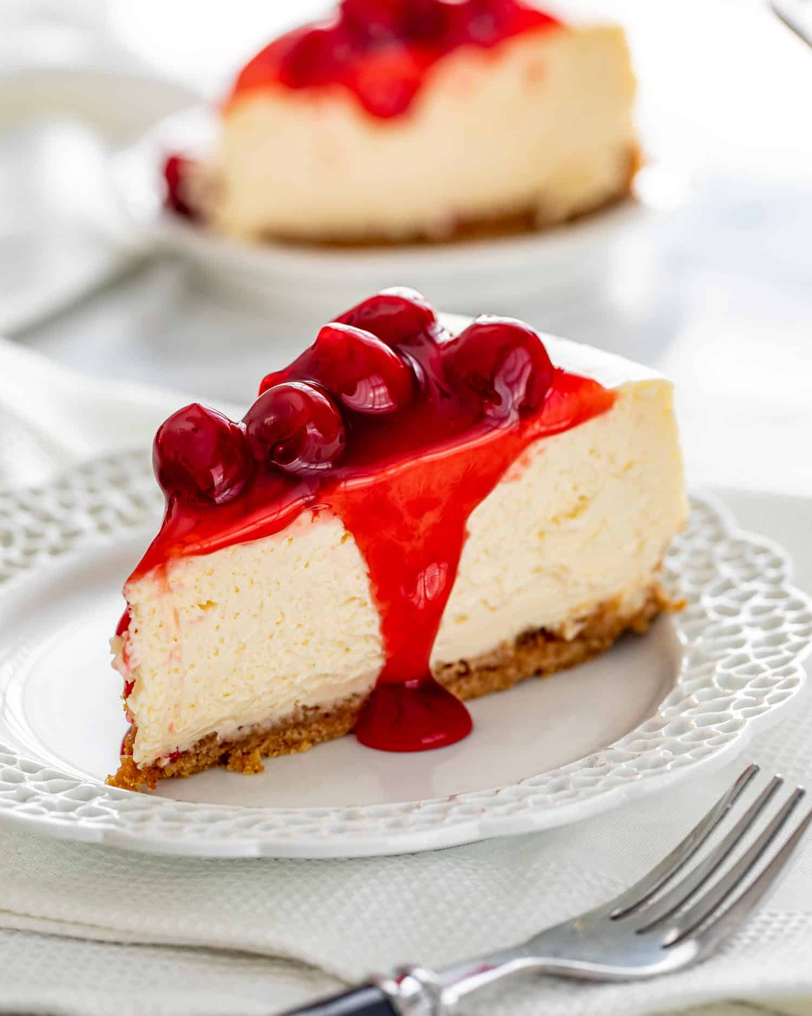
Elegantni Cheesecake
Notes:
Creamy Texture and Crust Options, Classic and Modern Toppings

Slide 30

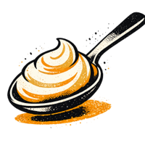

Kremasta tekstura i razne kore
Tipovi kore Sadrži korice od graham krekera, mrvice od keksa, tijesto i orašaste plodove, od kojih svaka nudi jedinstvene profile ukusa i teksture.
Karakteristike teksture Kremasta tekstura nastaje miješanjem krem sira, jaja i šećera; Sadržaj masti i stabilizatori dodatno utiču na osjećaj i čvrstoću usta.
Stilovi pečenja Pečeni cheesecakes su čvršći i gušći, dok su verzije bez pečenja lakše i mekše, što utiče na ukupnu kremastost i zadovoljstvo.
Notes:
Cheesecake’s hallmark is its rich, creamy texture achieved through smooth cream cheese blended with eggs and sugar. Crust options vary widely: traditional graham cracker crusts provide a sweet, crunchy base, whereas some recipes opt for cookie crumbs, pastry crusts, or nut-based crusts for added flavor complexity. The baking technique—whether baked or no-bake—affects texture and firmness. Rheological studies show that varying fat content and stabilizers influence creaminess and mouthfeel, which are key to consumer satisfaction. Image source: AI-generated

Slide 31
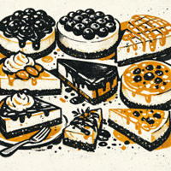
Klasični i moderni dodaci
Klasični voćni kompoti
Trešnja i borovnica donose svijetlu kiselost i bogatu slatkoću; Široko se preferira zbog svježine.
Moderni indulgencije
Slani karamel i čokoladni ganache dodaju duboku, maslenu bogatost za vrhunski osjećaj.
Svježi i lagani favoriti
Svježe voće i šlag balansiraju slatkoću sa prozračnom teksturom i čistim završetkom.
Avanturistički i slani
Redukcija balzamika i začinsko bilje uvode složenost; nišni, ali rastući interes.
Uvid u popularnost
Istraživanja pokazuju da izbor na vrhu pokreće kupovinu; Voće pobjeđuje po svježini i raskoši.
Notes:
Cheesecake toppings range from traditional fruit compotes like cherry or blueberry to modern innovations such as salted caramel, chocolate ganache, or exotic fruit glazes. Fresh fruit and whipped cream remain perennial favorites for their balance of sweetness and acidity. Contemporary trends include savory toppings like balsamic reduction or herbs to diversify flavor. Consumer surveys indicate that topping choice significantly impacts purchase decisions, with fruit toppings preferred for perceived freshness and indulgence. Image source: AI-generated

Slide 32
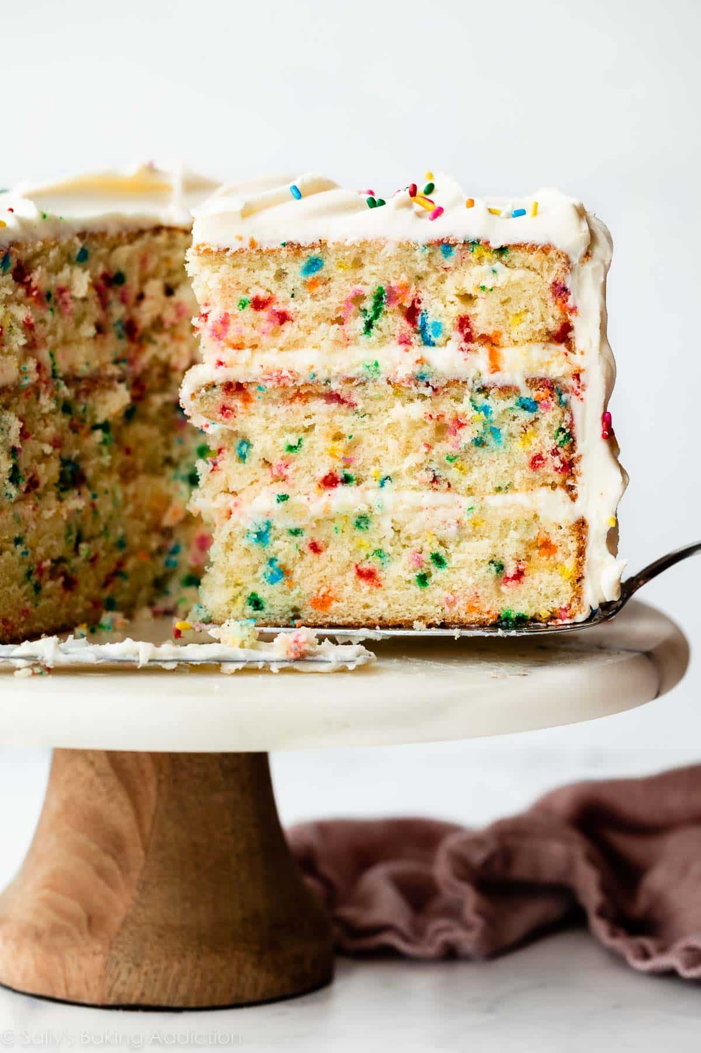
Colorful Funfetti Cake
Notes:
Sprinkle-Filled Batter, Perfect for Birthdays and Parties

Slide 33
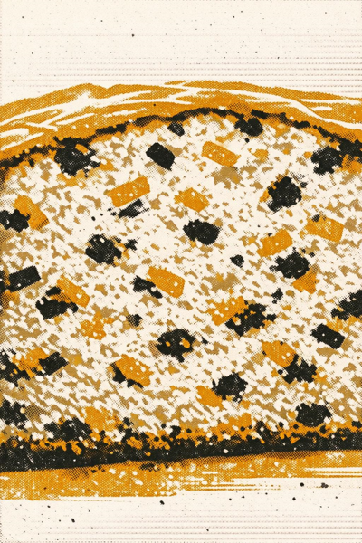
Smjesa punjena mrvicama
Obrada i vizuelni efekti Šarene mrvice se djelimično tope tokom pečenja, stvarajući živopisne tačkice i svečani presjek koji dodaje teksturu i vizuelni izgled.
Razmatranja sastojaka Studije ističu odabir stabilnih vrsta prskanja kako bi se smanjilo prolijevanje boje i osigurala dosljedna disperzija kroz mrvice.
Profil udarača na bazama Koristi se jednostavna vanilija smjesa koja upotpunjuje jarke boje i održava mekanu, vlažnu teksturu.
Potrošačka preferencija Popularnost dječijih zabava dostiže vrhunac zbog svijetlog izgleda i slatkog, svečanog ukusa.
Notes:
Funfetti cake is characterized by colorful candy sprinkles mixed into the batter, which melt partially and create a speckled, festive interior once baked. The sprinkles add texture and visual appeal that make the cake popular for celebrations. Ingredient studies highlight the importance of sprinkle type to prevent color bleed and maintain consistency during baking. The base batter is often a simple vanilla cake designed to complement the fun visual feature. Consumer preference data show Funfetti cakes are highest in popularity for children's parties due to their bright appearance and sweet taste. Image source: AI-generated

Slide 34
32,000
Funfetti torte prodane za rođendanske zabave prošle godine Najprodavanija torta za zabave—svijetla, prilagođena djeci i globalno popularna
Notes:
Funfetti cake’s bright colors and whimsical appearance make it a favorite for birthdays and festive events, particularly among children. It embodies celebration and joy, often paired with matching colorful frosting and decorations. Market research in the bakery industry identifies funfetti as a top-selling cake variant for party orders due to its visual impact and crowd-pleasing flavor profile. Its association with fun and youthfulness makes it a perennial choice for such occasions globally.

Slide 35
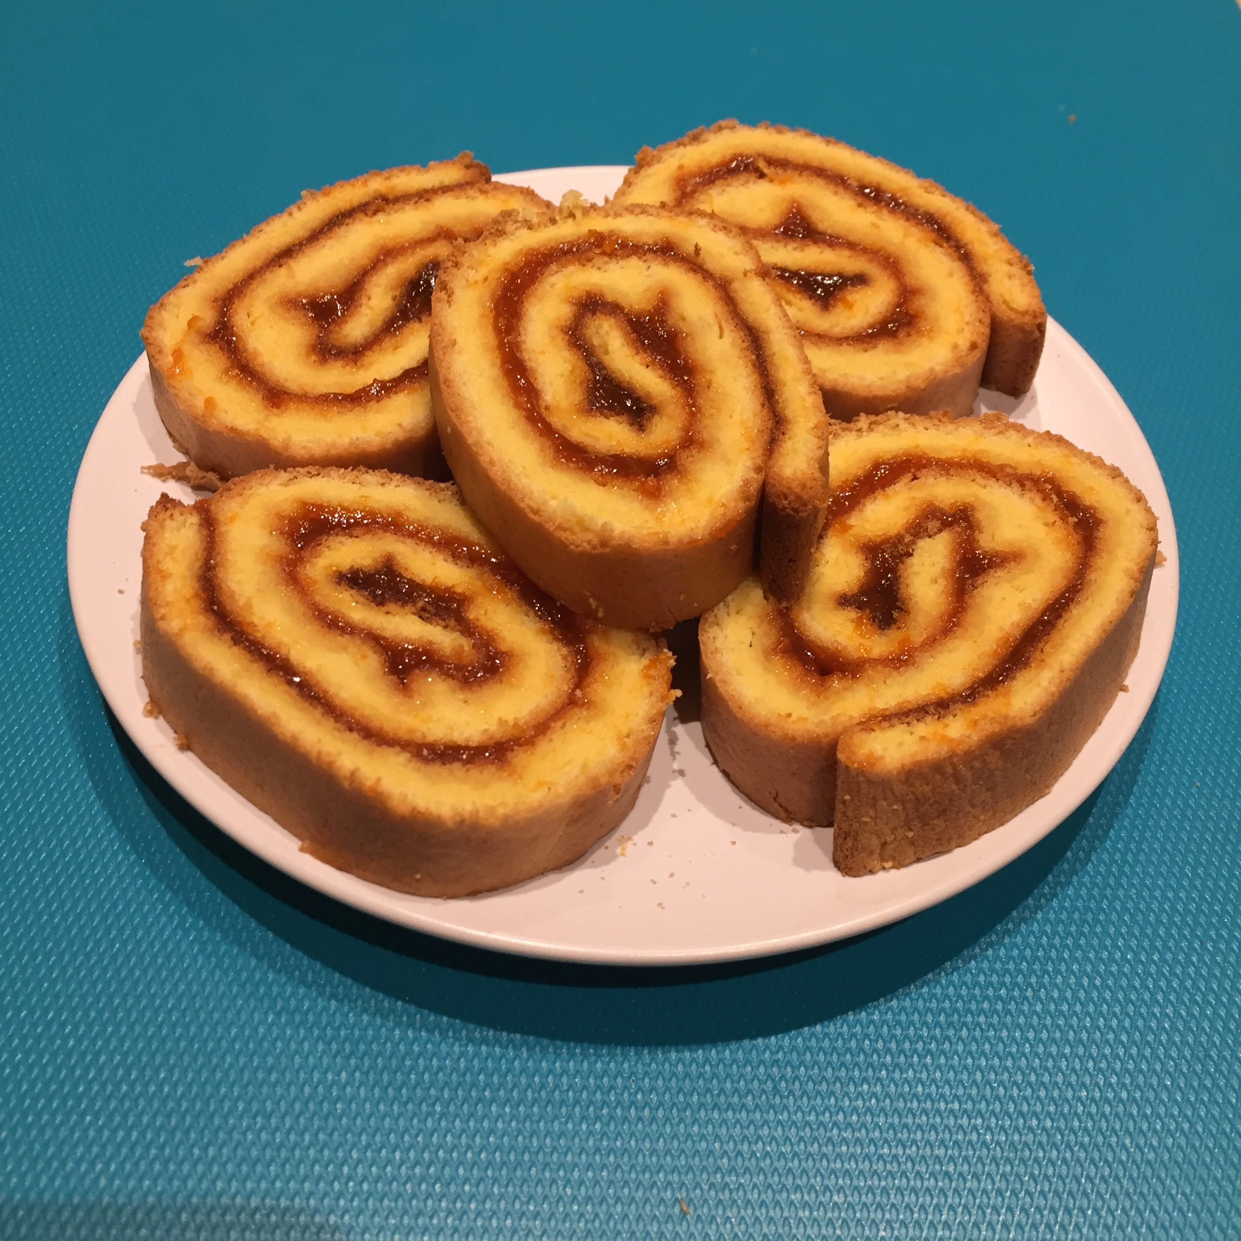
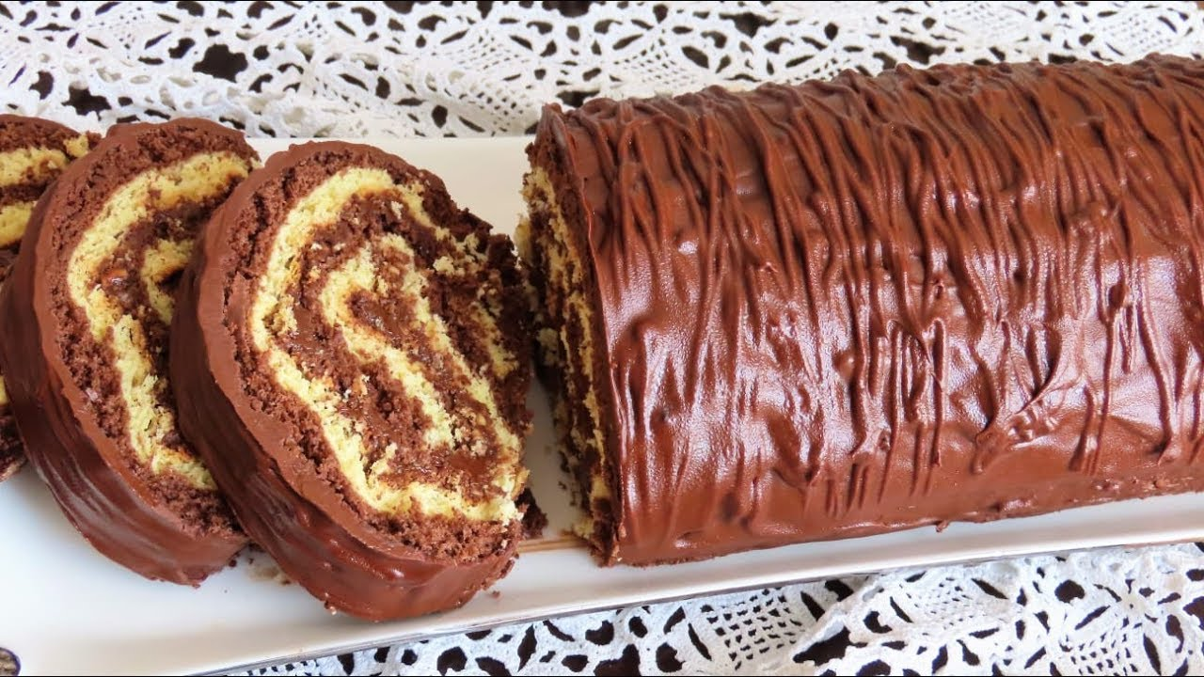
Rolat

Slide 36
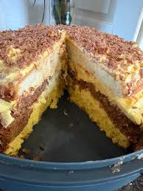
Ljubljanka

Slide 37
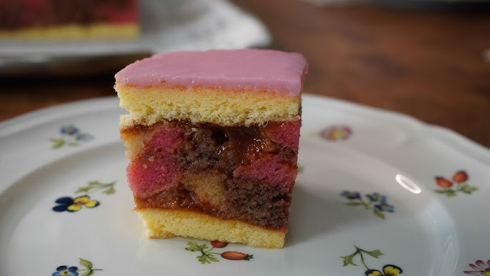
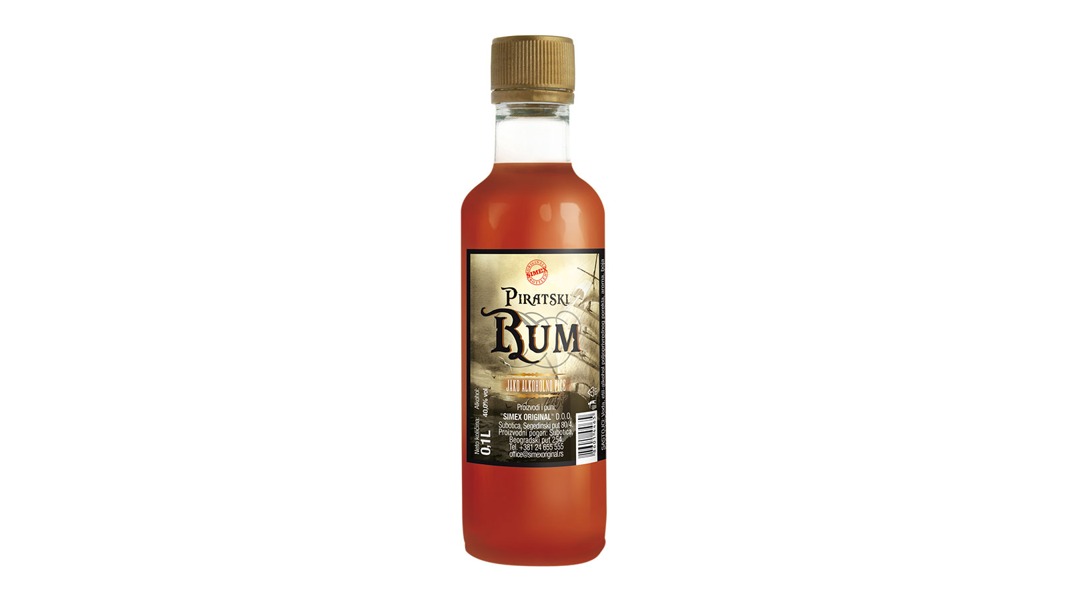
Rum torta

Slide 38
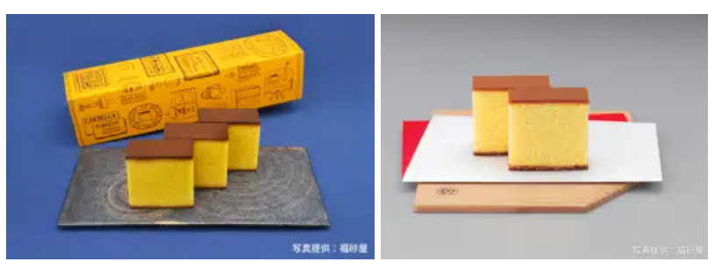
A u Japanu
Omiljeni desert među Japancima danas je castella, biskvit sa finijom, kompaktnijom teksturom od tradicionalnih kolača od maslaca

Slide 39
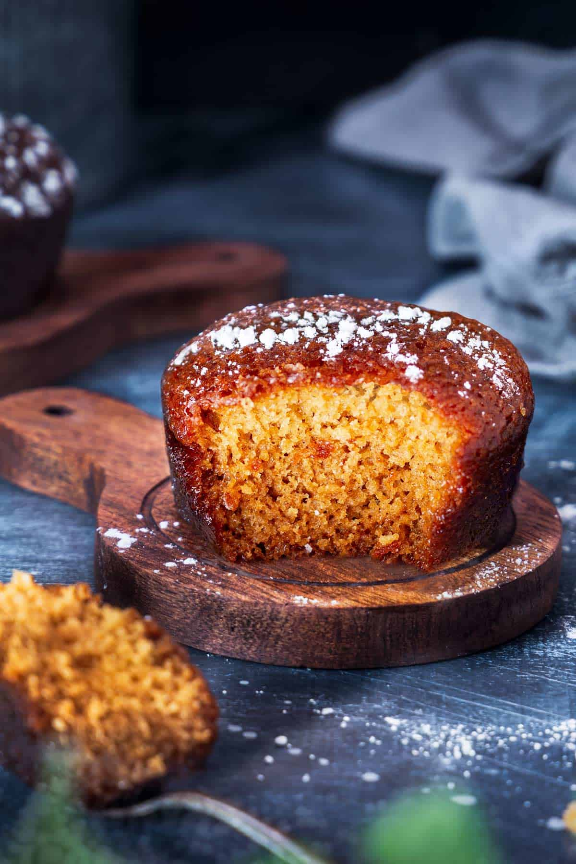
Južna Afrika
Malva puding
: Najpoznatija južnoafrička poslastica, zapravo je sočni, karamelizovani biskvit sa džemom od kajsija. Čim se izvadi iz rerne, preliva se slatkim sirupom od putera i pavlake, što mu daje izuzetno mekanu teksturu. Služi se topao uz engleski krem (custard) ili sladoled od vanile.

Slide 40
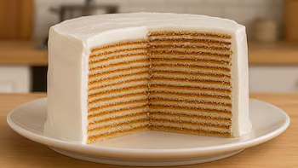
Argentina
25 korica
Dulce de leche (mleko+ secer+vanila)

Slide 41
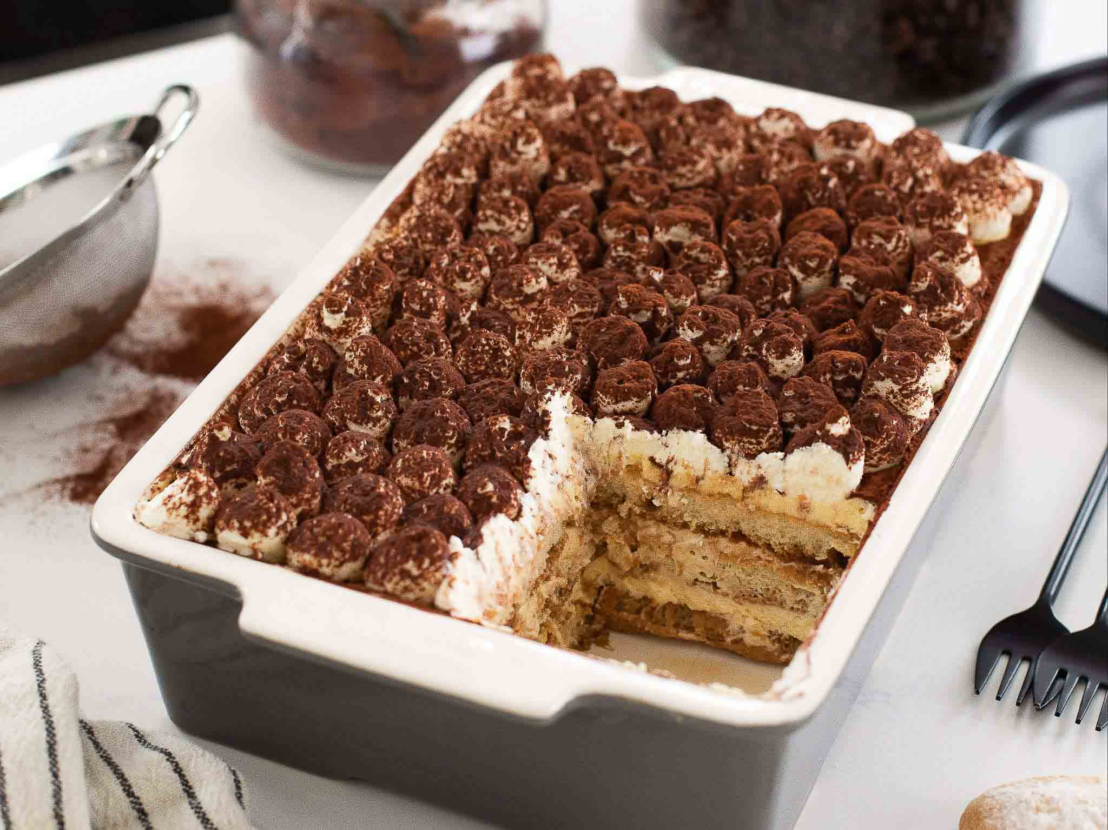
Italija tiramisu

Slide 42
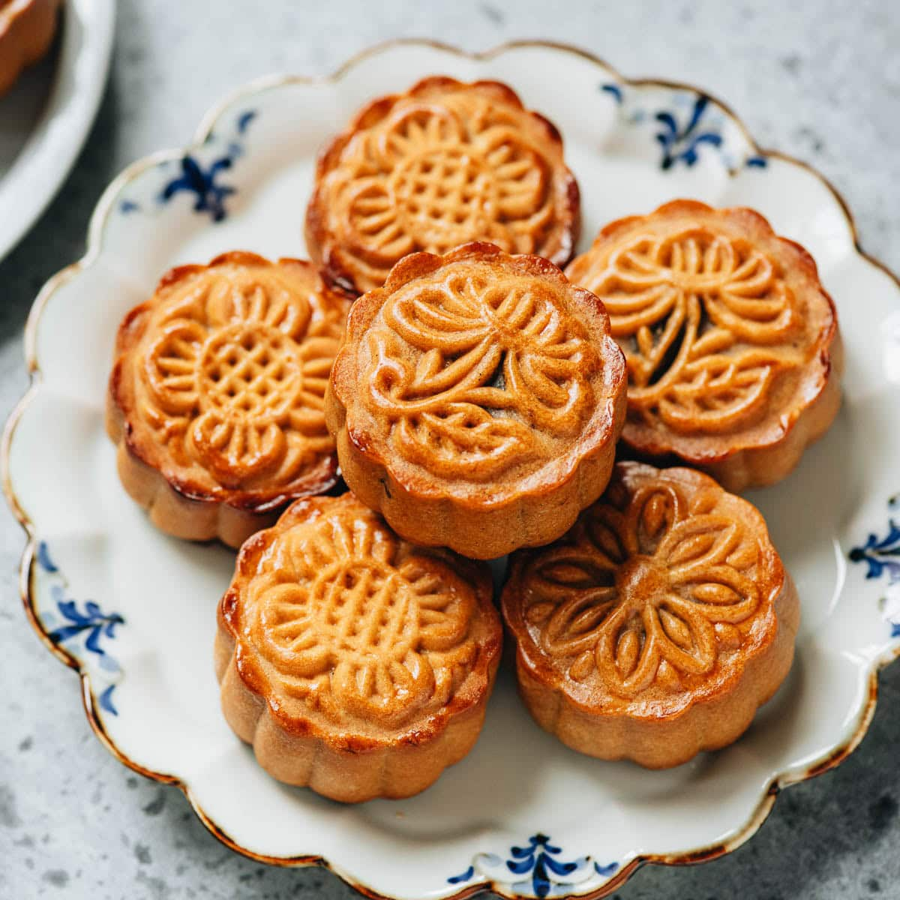
Kina
Mooncake (Mesečev kolač)
: Apsolutno najprodavanija tradicionalna slastica. Puni se pastom od lotosa, graha ili žumanjcima.

Slide 43
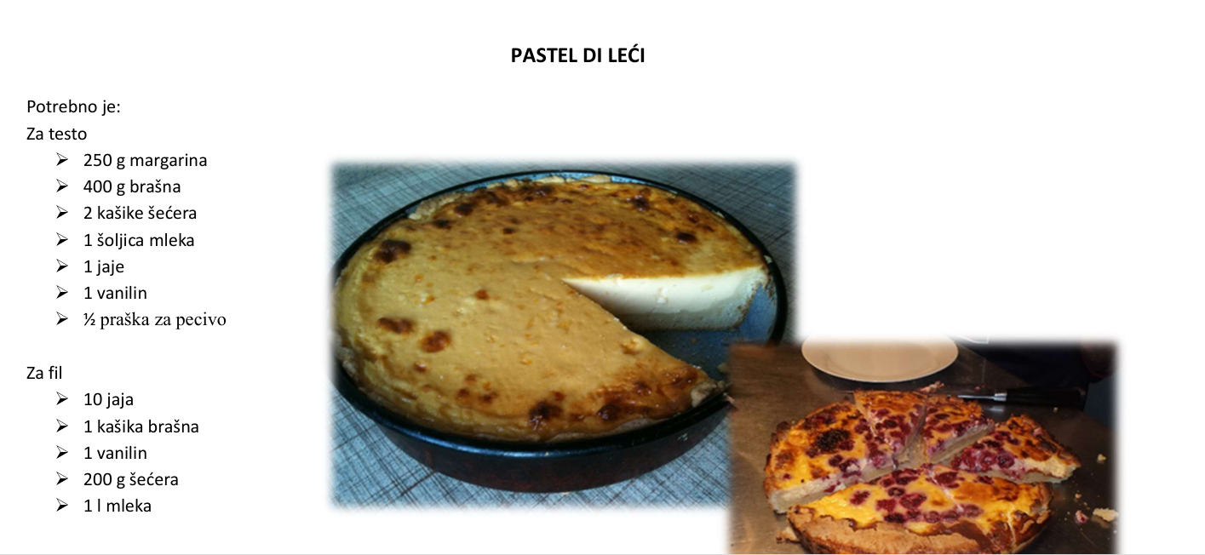
Sefardi

Slide 44
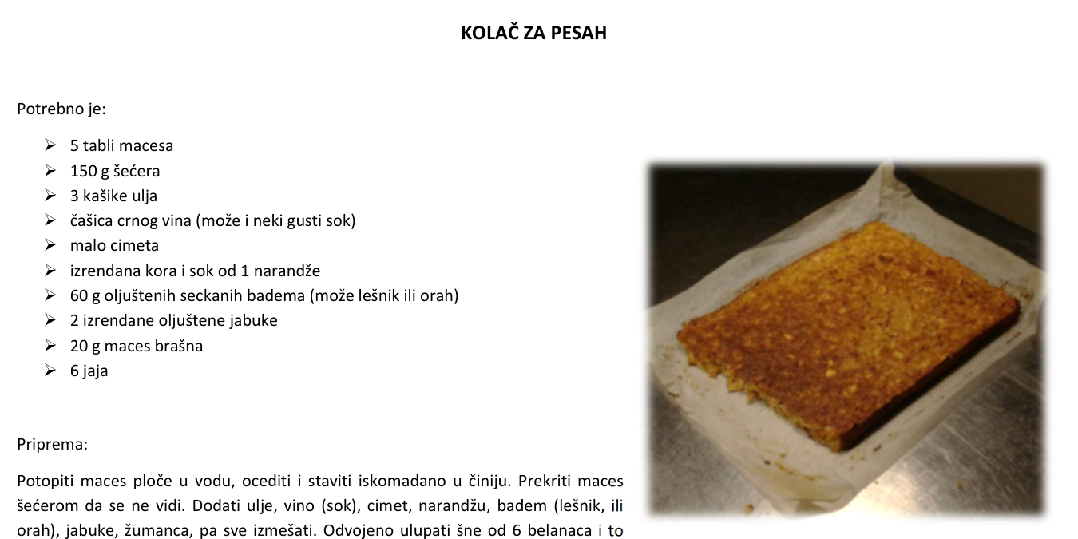

Slide 45
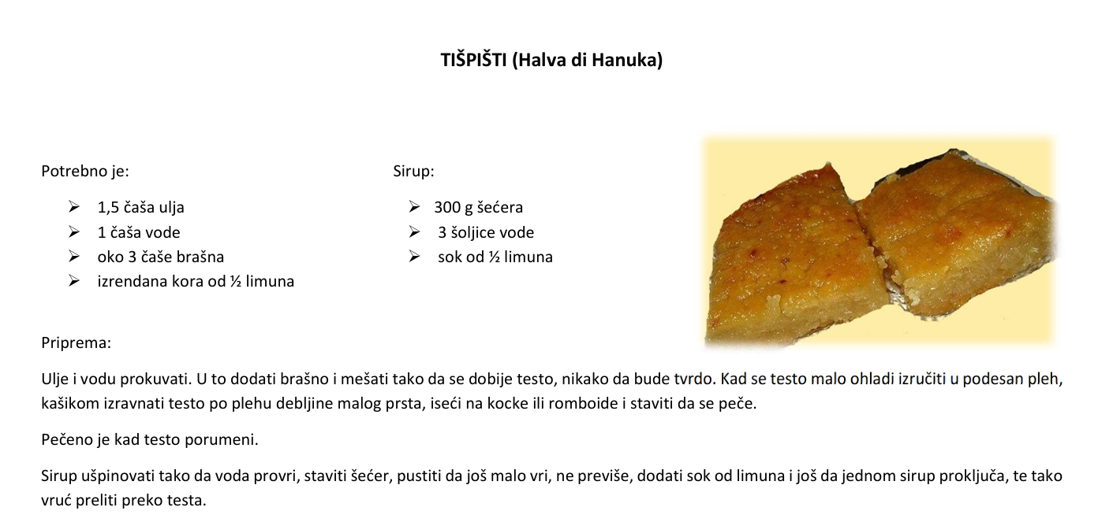

Slide 46
Zaključak: Proslava raznolikosti i užitka
Spektar ukusa Od čokolade do vanilije i jagode, kolači zadovoljavaju svaki ukus.
Teksture i tradicije Prozračni biskvitovi, kremasti cheesecake i prepoznatljivi crveni baršun nose priče.
Stvoreno za proslavu Funfetti i klasici podjednako donose radost prekretnicama i svakodnevnim poslasticama.
Stvarajte slatke uspomene Istražujte, uživajte i kreirajte svoja vlastita ukusna putovanja od kolača.
Notes:
This presentation explored a variety of beloved cakes, from the rich classic chocolate to the airy vanilla sponge, refreshing strawberry shortcake, vibrant red velvet, creamy cheesecake, and festive funfetti. Each cake offers unique flavors, textures, and traditions, highlighting the joyful versatility of cakes in celebrations and everyday indulgence. Embrace these delicious journeys and create your own sweet memories.

Slide 47
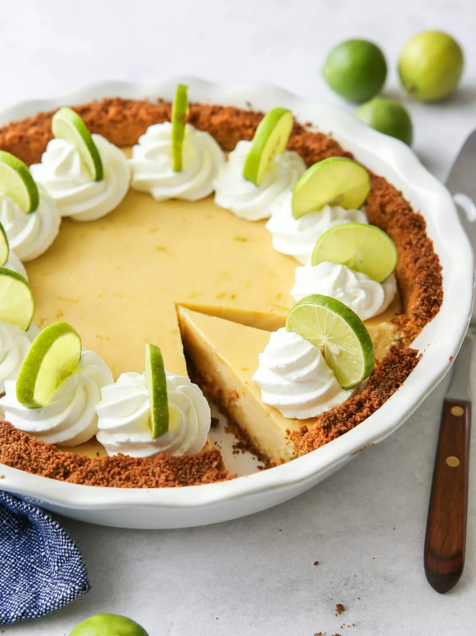
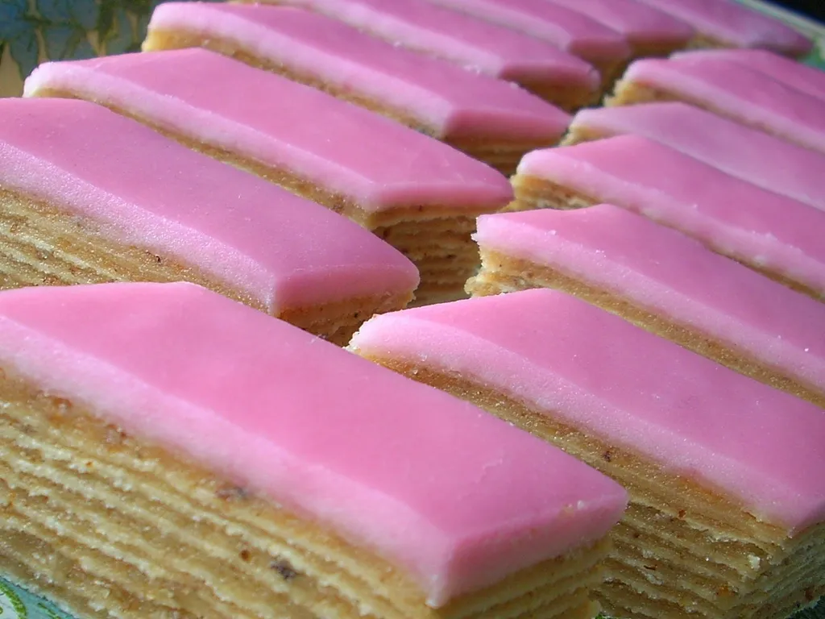
zaboravio
Key lime pie
Rozen torta
Kesten torta, i mnoge druge

Slide 48
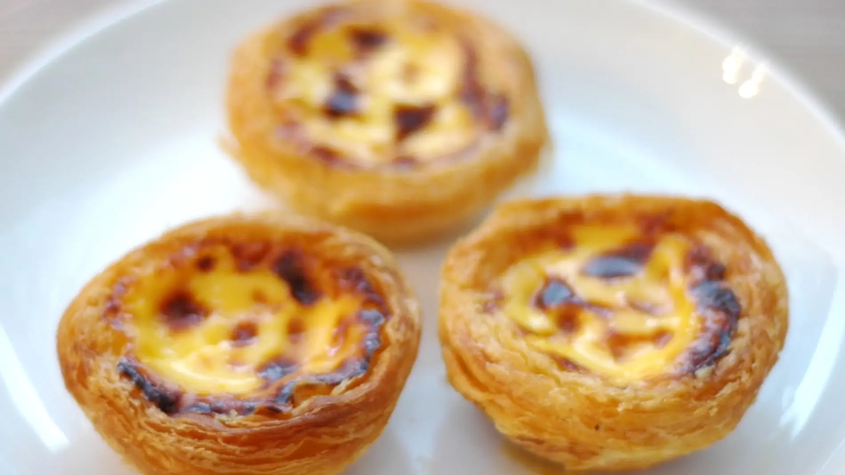
Archi je pitao za pastelitos de Belem

