Slide 1
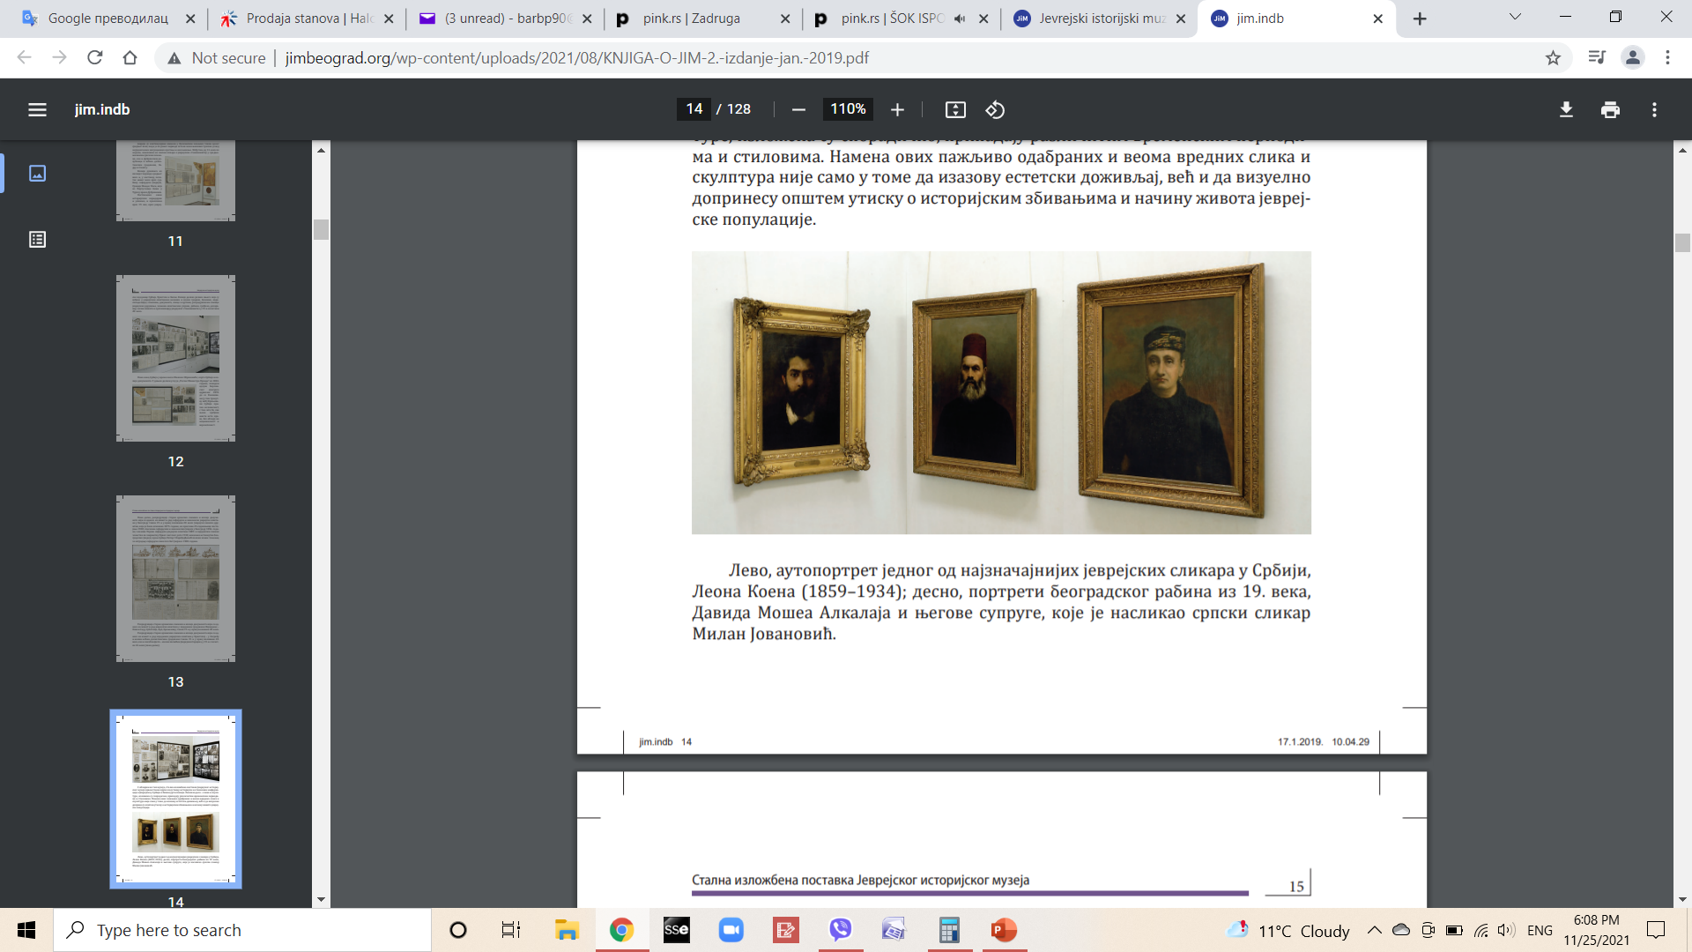
The Jewish Historical Museum’s
Art Collection

Slide 2
Within the Federation of Jewish Communities of Yugoslavia, the Historical-Museum Department, operated from 1945 to 1958, was established with the aim of locating and recovering, as far as possible, looted Jewish cultural-historical and artistic objects. For a full decade, through donations from individuals and Jewish communities, as well as through purchases, archival materials, Jewish ceremonial objects and traditional holiday items, old manuscripts, and works of fine art were acquired. This significant undertaking resulted in the opening of the Jewish Historical Museum in 1959 with a permanent exhibition and established collections.
The first inventoried item within the Arts Collection (paintings, drawings, sculptures) was the purchased work Eternal Jew by the Belgrade Sephardic painter Leon Koen (1859–1934). To date, around 600 works by Jewish artists or works with Jewish themes have been collected. The oldest item date from the first half of the 19th century and extend through the modern movements of the 20th century. In addition to amateur painters and anonymous authors, the collection includes works by over 100 renowned national and international artists – Bora Baruh, Moša Pijade, Daniel Ozmo, Daniel Kabiljo, Oskar Herman, Oskar Nemon, Albert Alcalay, Nandor Glid, Đorđe Bošan, Eva Fischer, Radovan Hiršl, Stepan Kolesnikov, Miloš Babić, Ksenija Divjak, Gabrijel Jurkić, Petar Palavičini, Sandu Liberman, Alfred Lakos, Avraham Omri, and others.

Slide 3
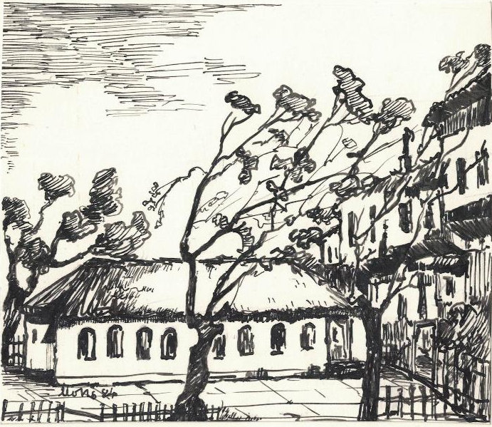
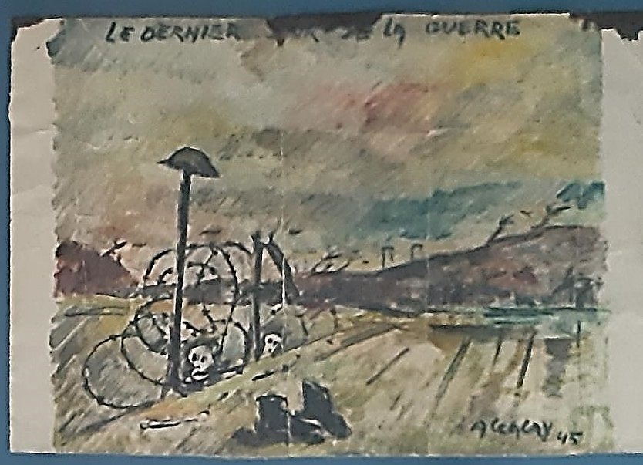
ABINUN MORIS
(1910 – 1993)
ALCALAY ALBERT
(1917 – 2008)
Synagogue in Stefan Visoki Street
1984, felt-tip on paper, 16x13,5 cm
The last day of the War
1945, oil on cardboard, 33x50 cm

Slide 4
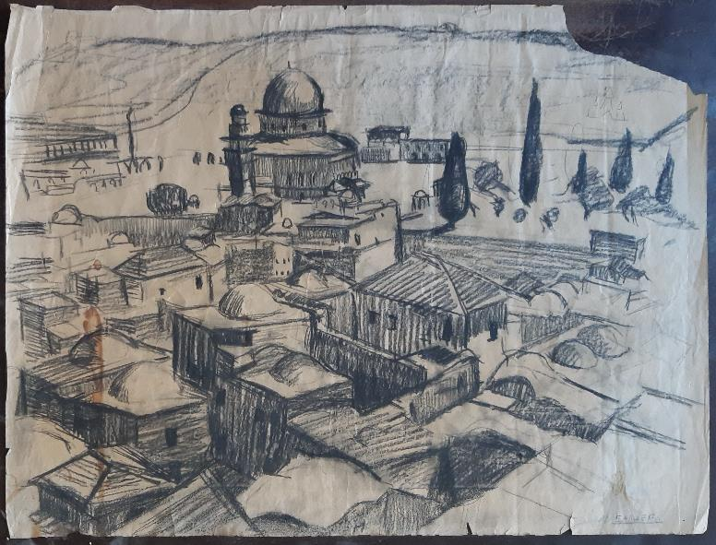
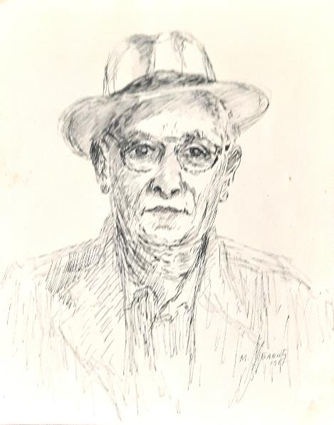
ALCHEH ELIEZER
(1908 – 1983)
BABIĆ MILOŠ
(1904 – 1968)
Jerusalem
1936-37, charcoal on paper, 47x62 cm
Portrait of Isak Alkalaj
1957, ink on paper, 24x18,5 cm

Slide 5
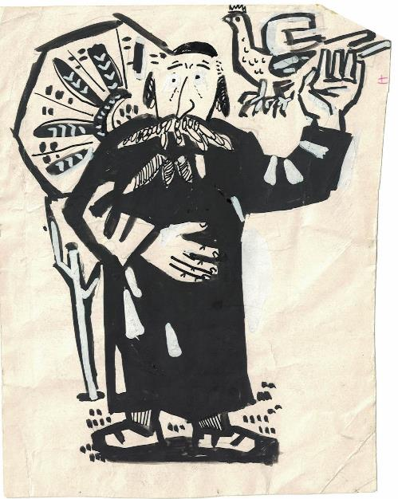
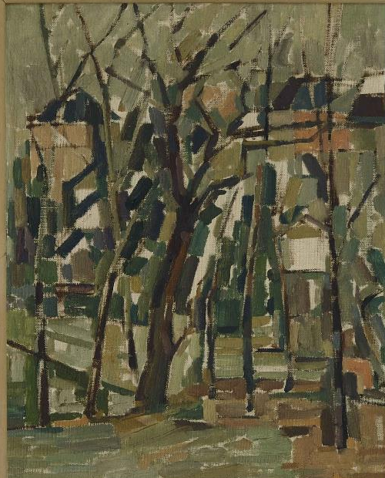
BARARON JAKOV
(1939 – )
BARUH BORA
(1911 – 1942)
Old Jew
1967, ink and tempera on paper, 14,5x11 cm
Veduta of Paris
1937, oil on canvas, 48,5x39 cm

Slide 6
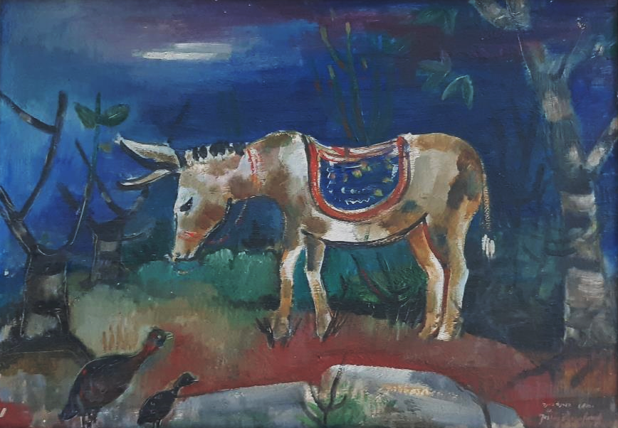
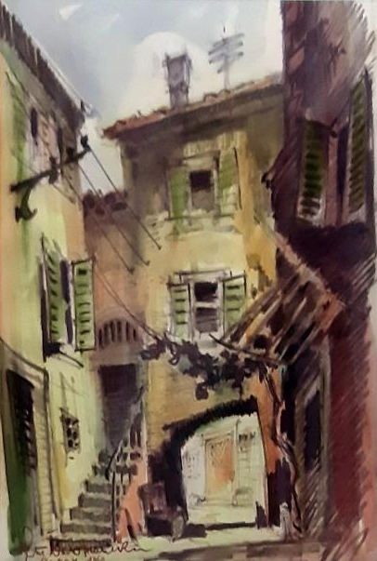
BAUERNFREUND JOSHUA
(1915 – 1990)
BELOŽANSKI STAŠA
(1924 – 1995)
Untitled
1951, oil on hardboard, 48,5x692 cm
Jewish Square in Piran
1960, watercolor on paper, 41,5x31 cm

Slide 7
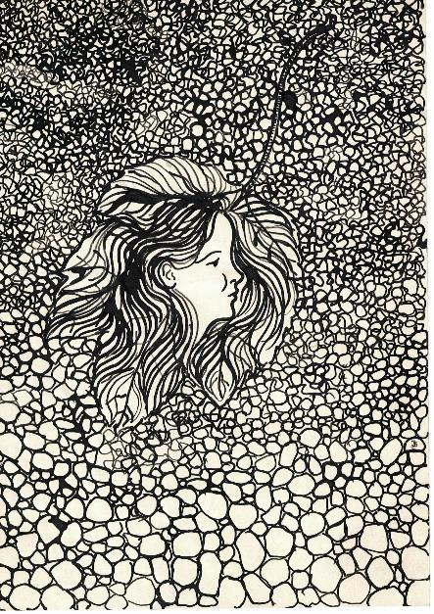
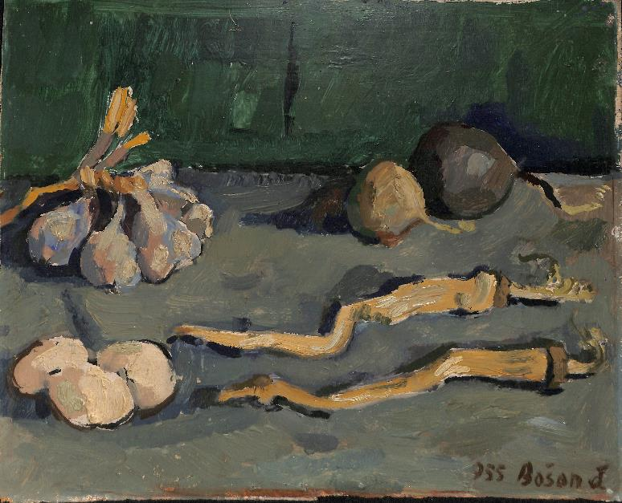
BLAJER IVAN
(1953 – )
BOŠAN ĐORĐE
(1924 – 1995)
Memory of Tanja
ca. 1970, felt-tip on paper, 21x15 cm
Still life
1955, oil on plywood, 32,5x39,5 cm

Slide 8
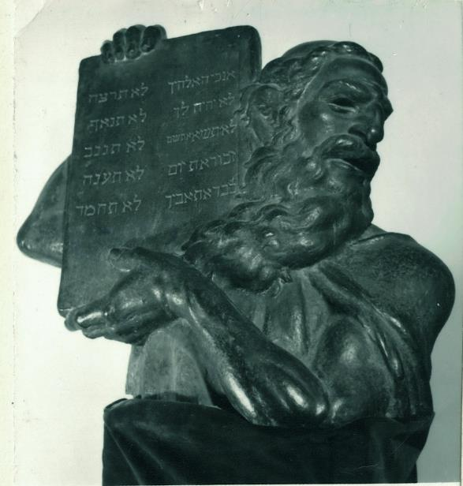
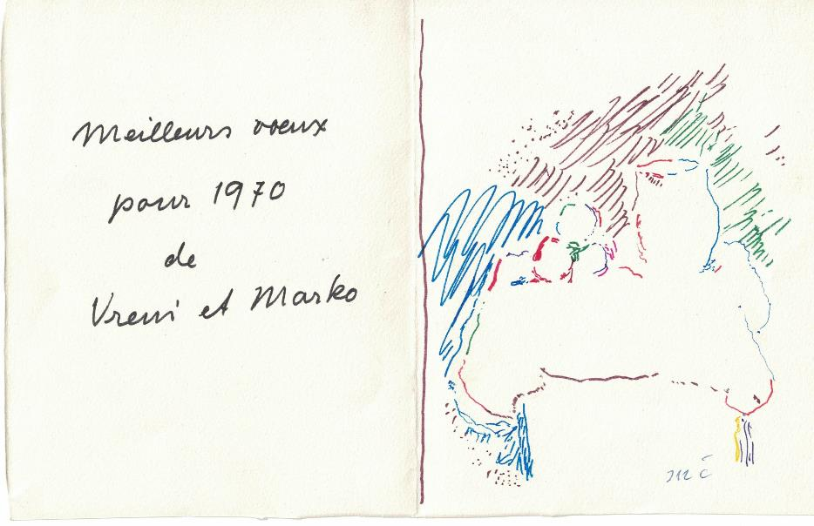
BRILL SLAVKO
(1900 – 1943)
ČELEBONOVIĆ MARKO
(1902 – 1986)
Moses
1936, bronze, 67,5x78x43 cm
Greeting card
1969, felt-tip on cardboard, 16x25 cm

Slide 9
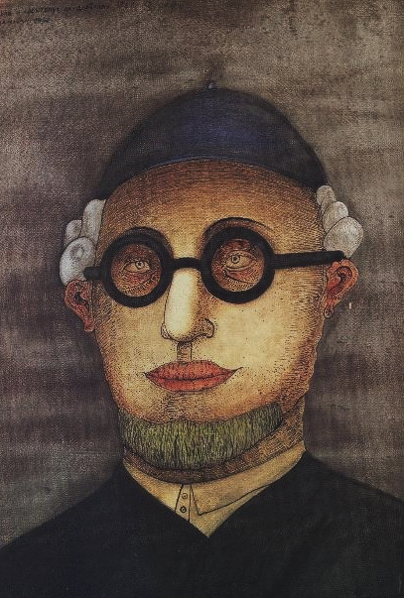
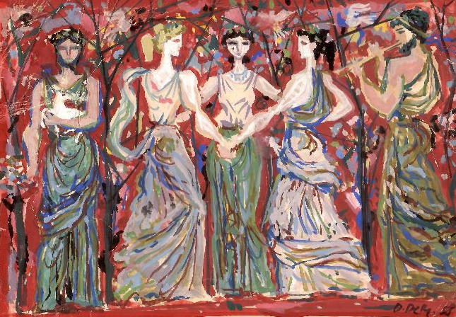
DAMNJANOVIĆ RADOMIR DAMJAN
(1935 – )
DIDA DEMAJO
(1906 – 1964)
Rabbi from Dorćol
1958, watercolor, ink, pencil and wax chalk on paper, 70,3x50,2 cm
Dance
1958, gouache, 15,5x22 cm

Slide 10
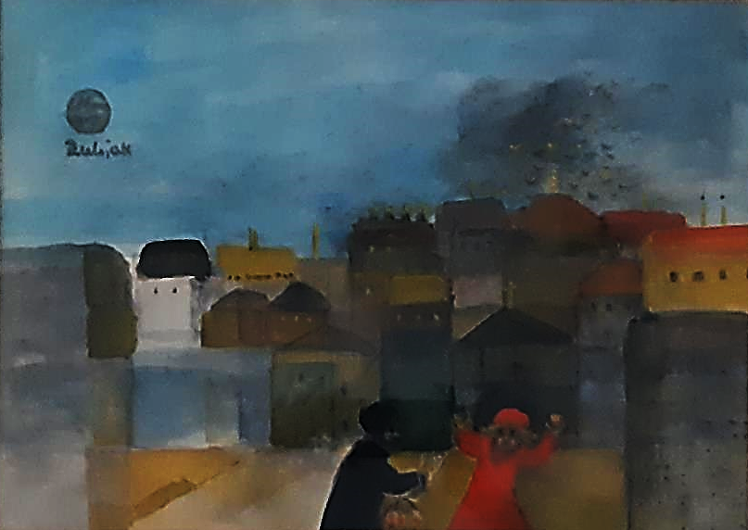
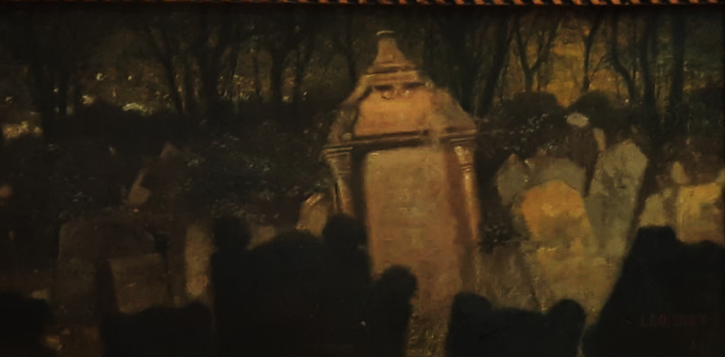
DIET (DIETMANN) LEO
(1857 – 1942)
DIVJAK KSENIJA
(1924 – 1995)
Jewish cemetery in Prague
undated, oil on canvas, 20x39 cm
Small town near Caesarea 1967 – Little shout
1990, watercolor, 31,5x43,5 cm

Slide 11
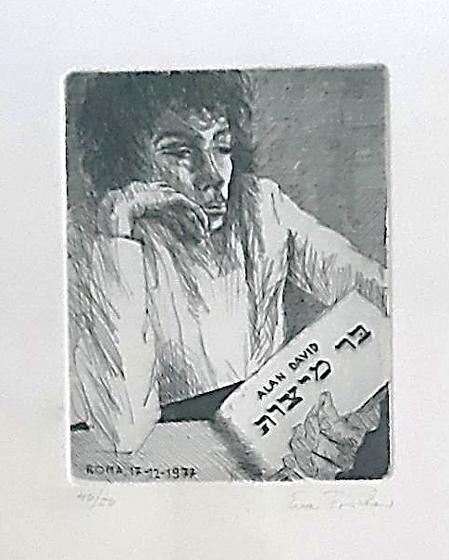
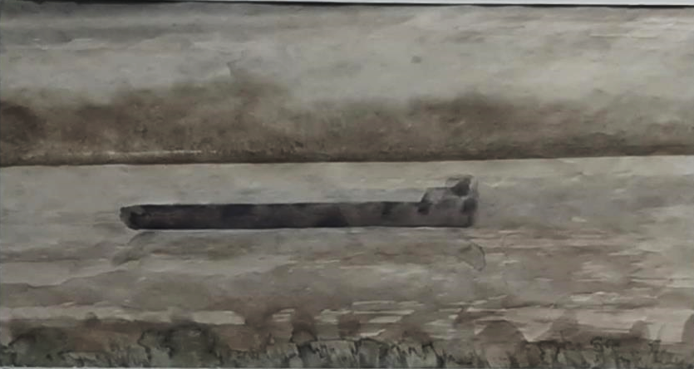
ELAZAR JOSIP
(1916 – 1994)
FISCHER EVA
(1920 – 2015)
Barge
1977, watercolor, 19,5x43,5 cm
Alan David – Bar mitzvah I
1977, engraving, 16x12 cm

Slide 12
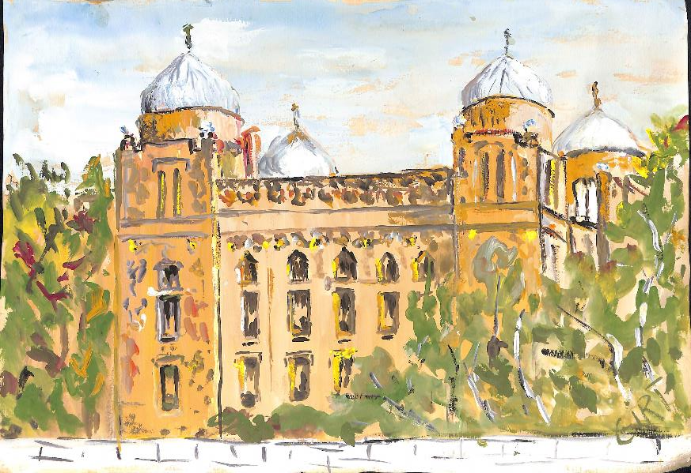
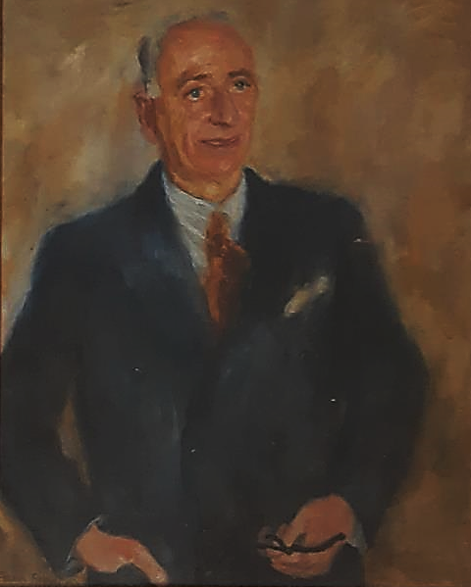
FRIGYES FRANK
(1890 – 1976)
GIRT ILONKA
(1906 – 1985)
Portrait of ing. Frank
1938, oil on canvas, 90x72 cm
Sarajevo Ashkenazi synagogue
1974, watercolor on paper, 24x35 cm

Slide 13
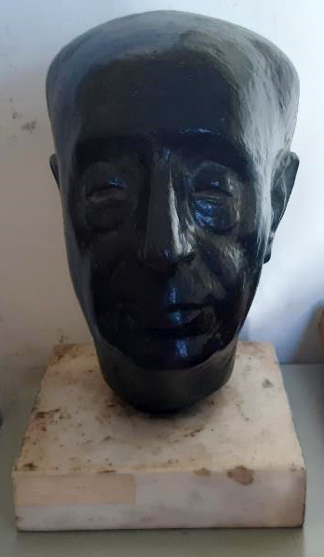
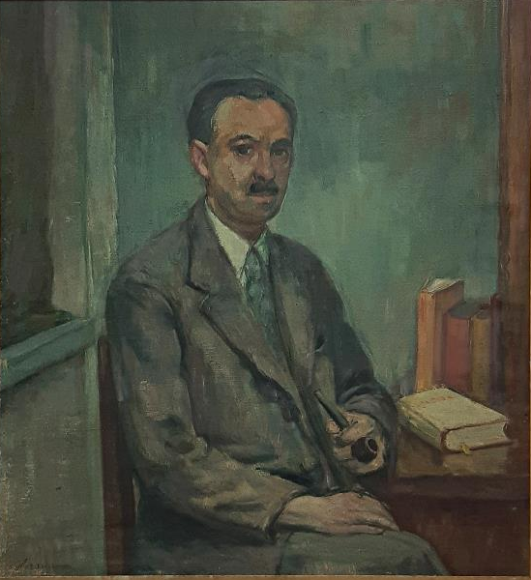
GLID NANDR
(1924 – 1997)
HERMANN OSKAR
(1886 – 1974)
Portrait of Dr. Zoltan Lorant
1959, bronze, 30x20x25 cm
Portrait of Robert Weith
undated, oil on canvas, 98x88 cm

Slide 14
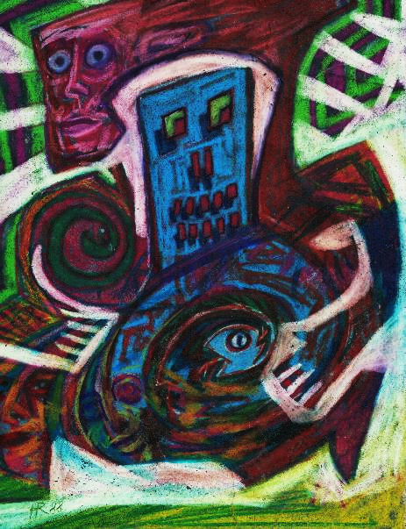
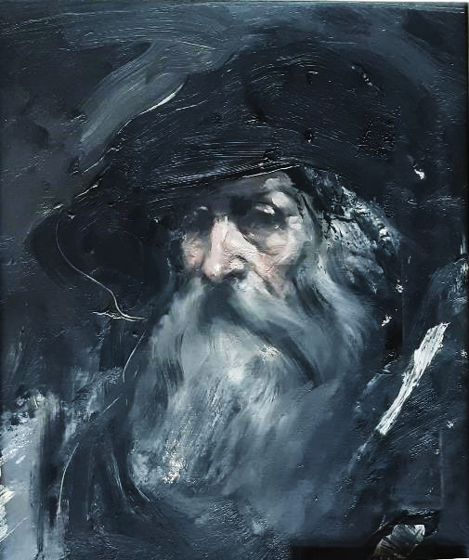
HIRŠL RADOVAN
(1924 – 1997)
JUKUNDUS BARD
(1949 – 1986)
Runner
1988, laser printing, 31x23 cm
Baal Shem Tov
1978, oil on canvas, 50x40 cm

Slide 15
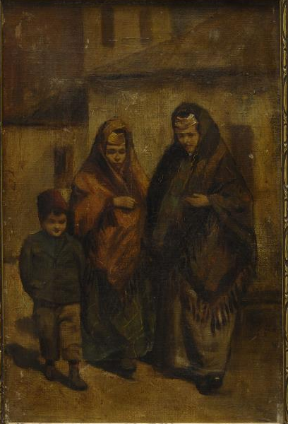
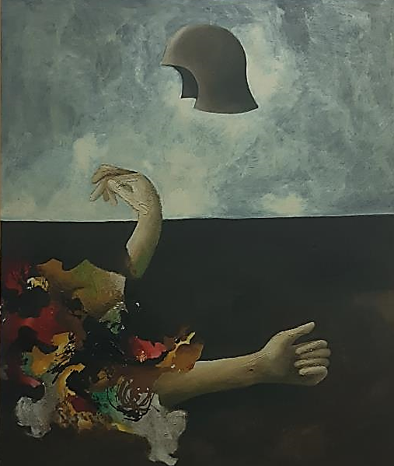
KABILJO DANIEL
(1894 – 1944)
KAVURIĆ VANJA
(1945 – 1977)
Sephardic women on a street in Sarajevo
ca. 1920, oil on canvas, 29x19 cm
Somewhere
ca. 1970, oil on canvas, 120x100 cm

Slide 16
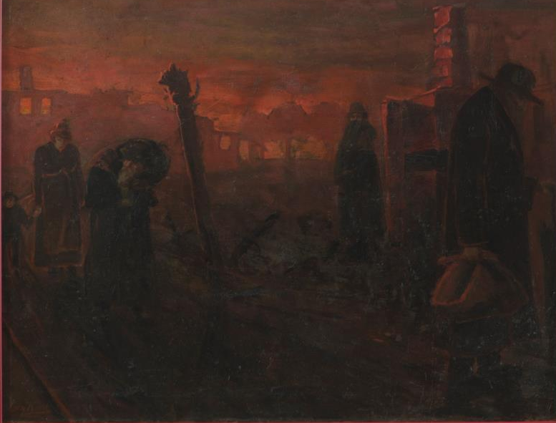
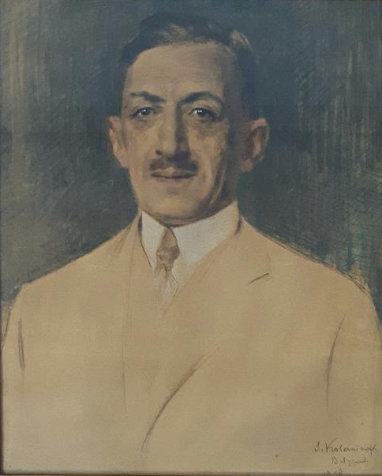
KOEN LEON
(1859 – 1934)
KOLESNIKOV STEPAN
(1879 – 1955)
Pogrom
undated, oil on canvas, 69,8x89,2 cm
Portrait of Šemaja Demajo
1932, chalk on cardboard, 64x69 cm

Slide 17
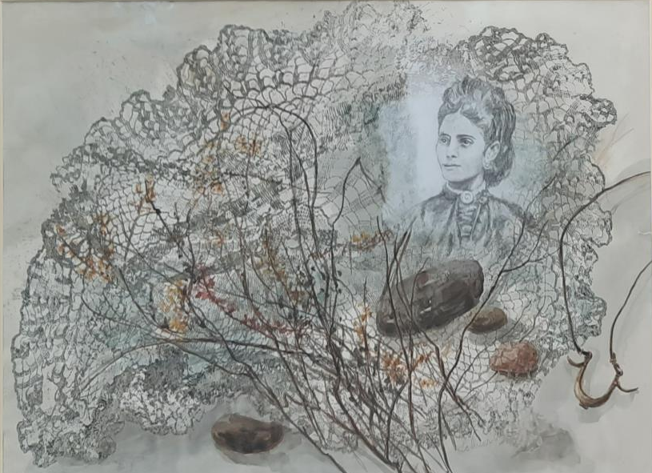
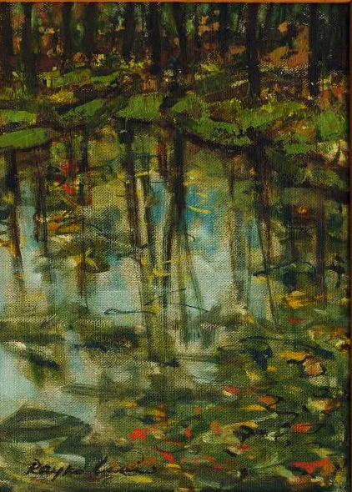
LEHNER DRAGIĆ MIRJANA
(1936 – )
LEVI RAJKO
(1904 – 1986)
Memory of Toni Azriel
1987, acrylic, watercolor and pencil on paper, 56x77 cm
Lanscape
1970, oil on hardboard 40,5x30,5 cm

Slide 18
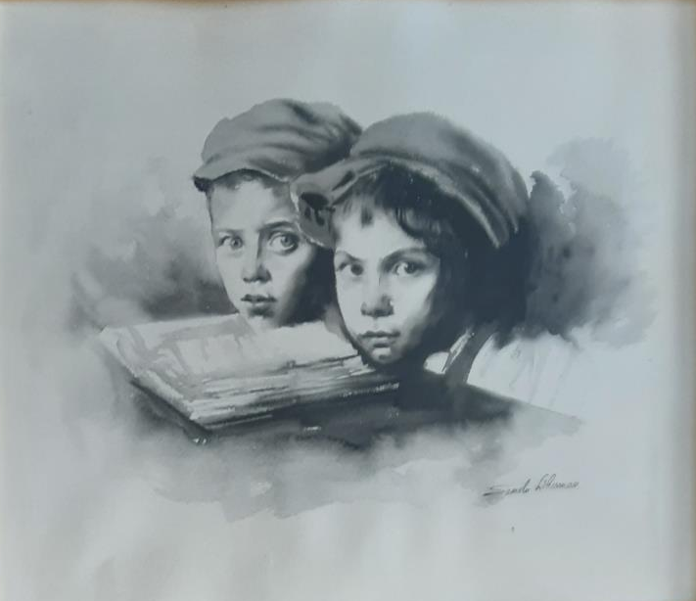
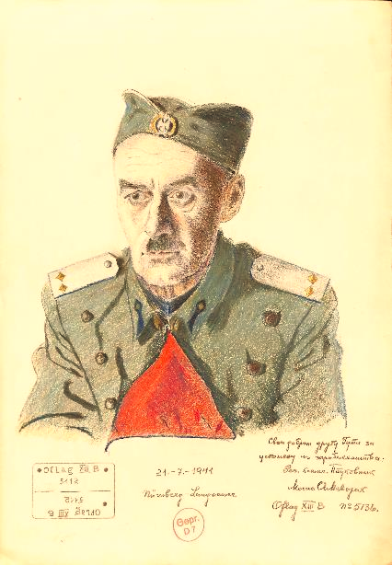
LIBERMAN SANDU
(1923 – 1977)
MEVORAH MOŠA
(1890 – 1982)
Boherim
ca. 1970, ink on paper, 52x62 cm
Portrait No.6 - Guta
1941, pencil on paper, 42x30 cm

Slide 19
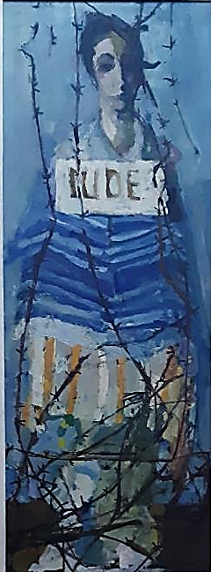
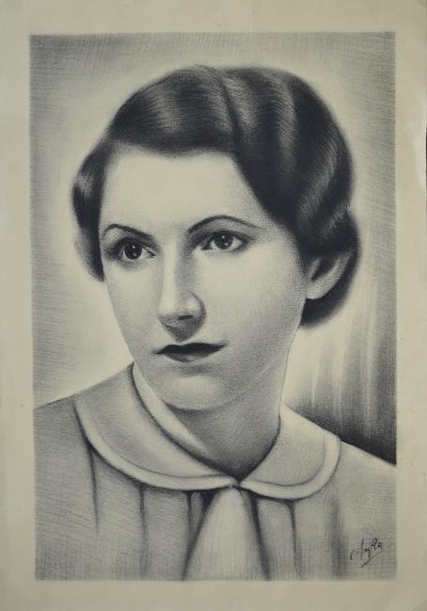
MILOVANOVIĆ DUŠAN
(1919 – 2000)
MLADENOVIĆ LUKA
(1909 – 2000)
Woman prisoner
undated, oil on wood, 173x63,5 cm
Portrait of Dr. Lora Nahmijas
undated, pencil on paper, 55,5x36 cm

Slide 20
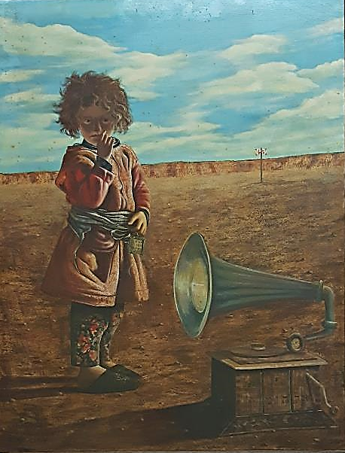
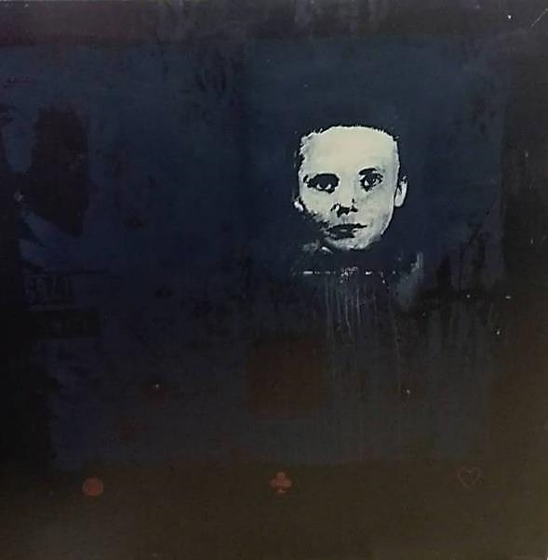
NASTIĆ ZORAN
(1948 – )
NIKOLIĆ GABRIJELA
(1967 – )
Isaac
1977, acrylic on paper, 90x120 cm
Matilda is not here
2013, oil on painting, silk screen, 105x105 cm

Slide 21
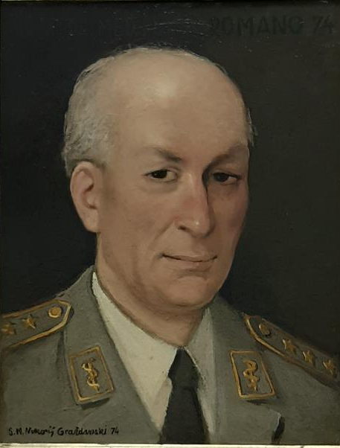
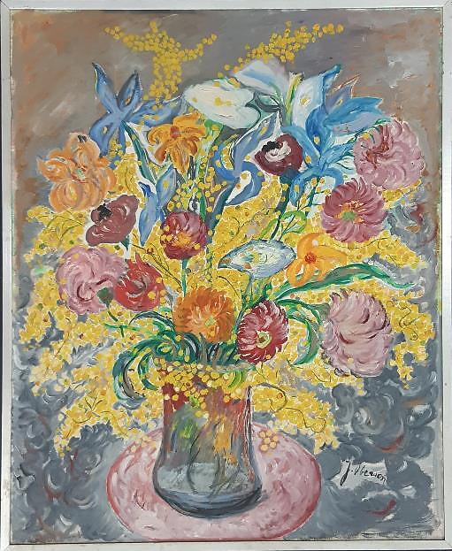
NIKOLIĆ SAVA GRAŽDANSKI
(1920 – 1981 )
OBERSON JOLA
(1910 – 1992)
Portrait of Dr. Romano
1974, oil on hardboard, 56,5x43 cm
Flower bouquet with mimosas
undated, ol on canvas, 75x62 cm

Slide 22
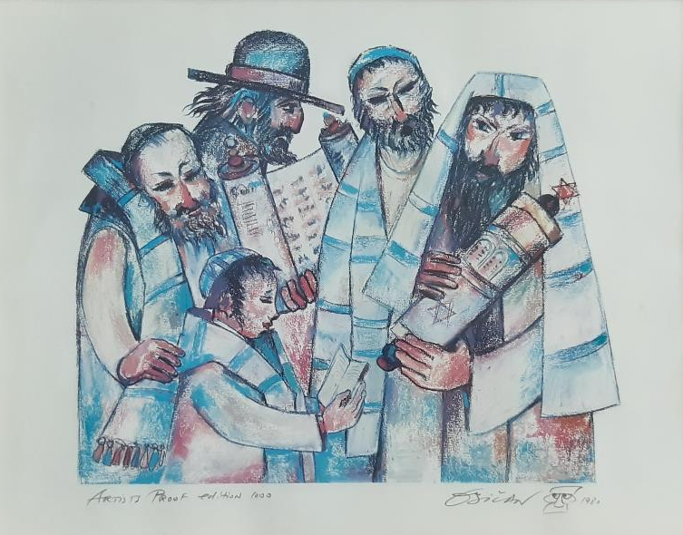
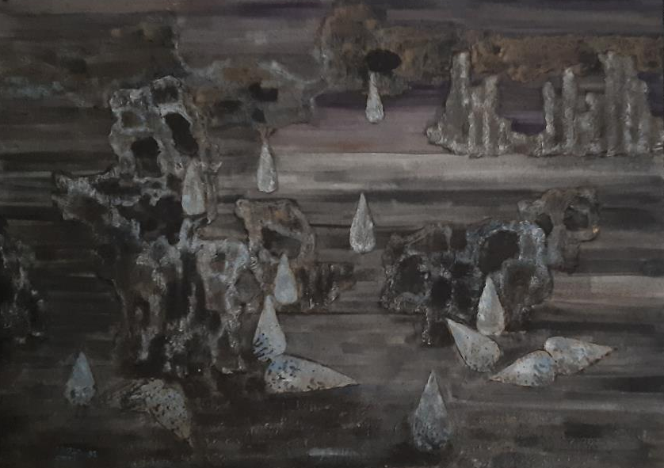
OBIČAN JOVAN
(1918 – 1981 )
OMRI AVRAHAM
(1914 – 2010)
Teaching the Youth
1980, lithograph, 41x52 cm
Petrified tears
1982, oil on canvas and sand, 78x101 cm

Slide 23
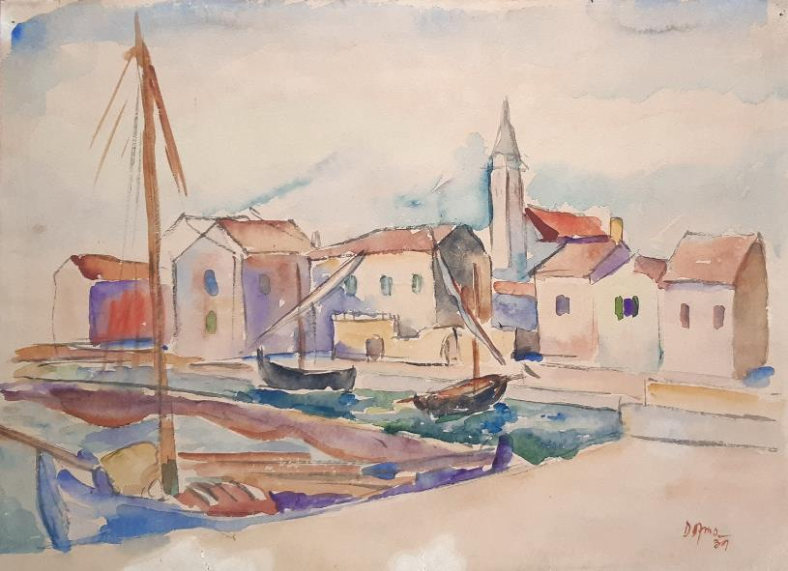
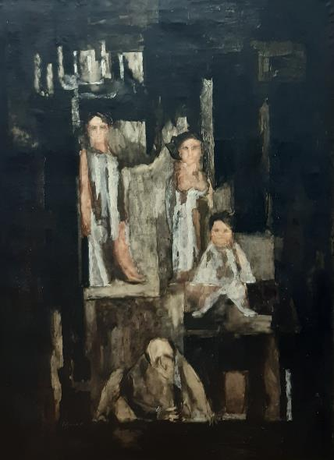
OZMO DANIEL
(1912 – 1942)
PAJEVIĆ TATJANA
(1933 – )
Adriatic landscape
1939, watercolor on paper, 36x48,5 cm
Court of Israel – Trial of Eichmann
1961, oil on canvas, 145x113 cm

Slide 24
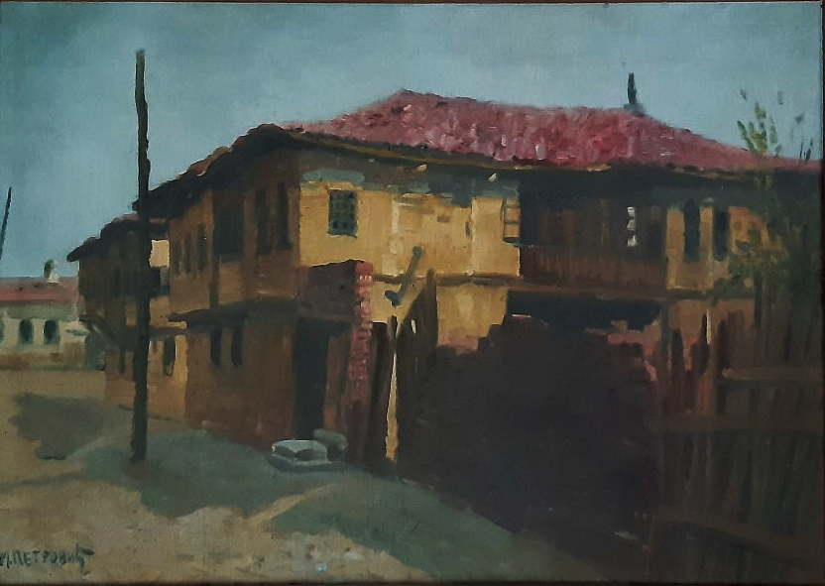
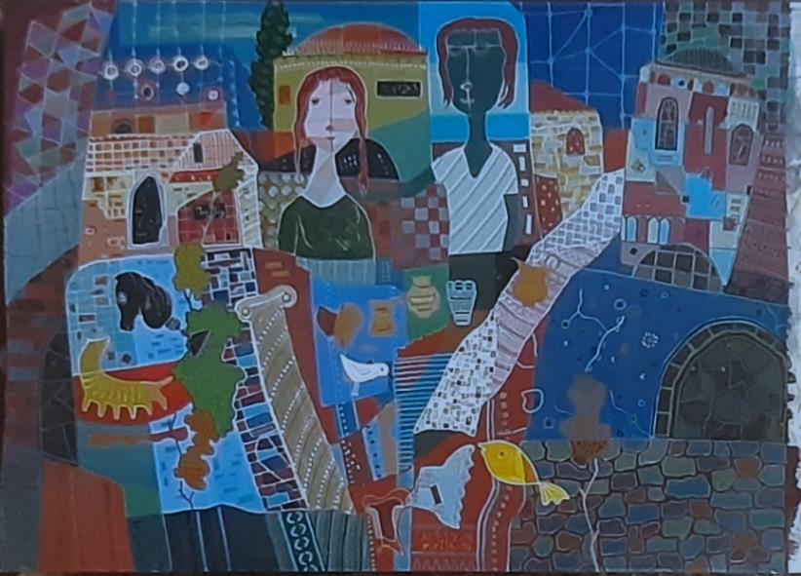
PETROVIĆ MIODRAG
(1888 – 1950)
RILA RAFAEL
(1907 – 1993)
Solunska Street – Jewish quarter
1930, oil on hardboard, 35x51 cm
Old jugs with a bird and a goldfish near the ancient pillar
1978, varnished gouache, 35x50 cm

Slide 25
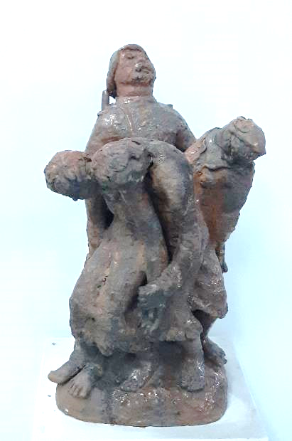
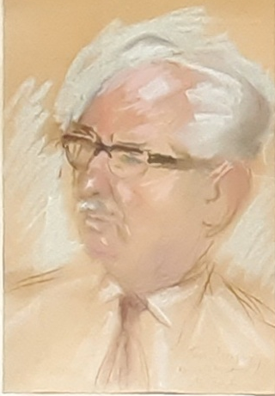
SKOPAL STELA
(1904 – 1992)
ŠERBAN MILENKO
(1907 – 1979)
Female prisoners
1945, terracotta, 52x31x31 cm
Portrait of Hinko Lederer
undated, chalk on cardboard, 40x27,5 cm

Slide 26
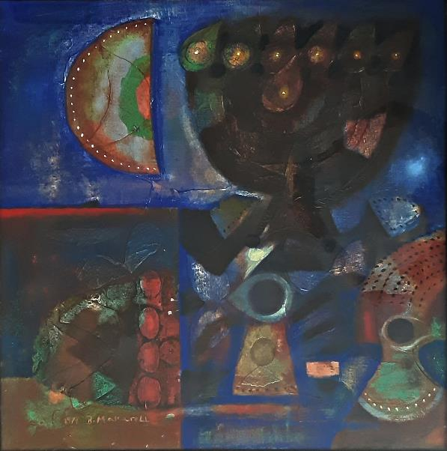
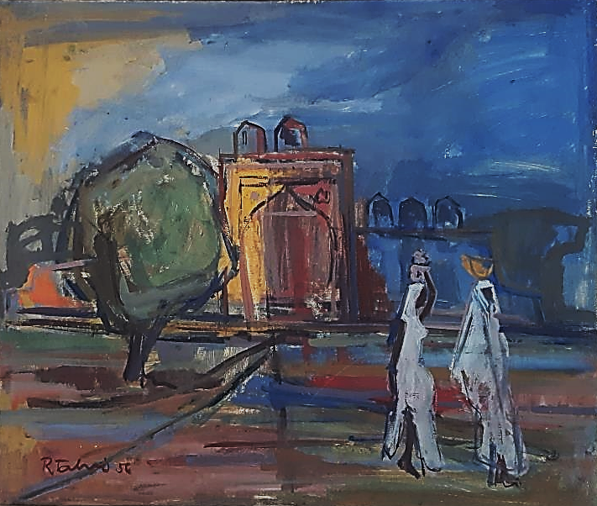
MASKARELI BRUNO
(1926 – 2019)
TALVI RAFAEL
(1907 – 1979)
Promised morning
1971, oil on canvas, 71x71 cm
India II
1956, oil on hardboard, 53x66 cm

Slide 27
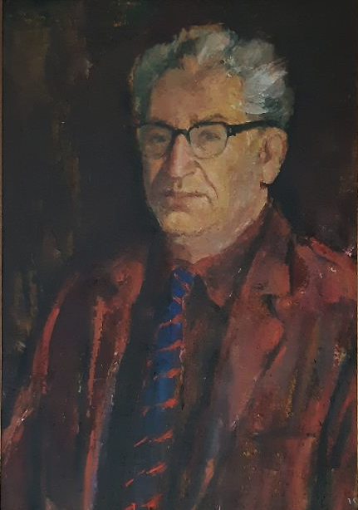

VUKOVIĆ SVETISLAV
(1901 – 1978)
VAJLER ADOLF
(1895 – 1969)
Portrait of Dr. Žak Konfino
1946, oil on canvas, 68,5x45,6 cm
Old man
undated, pastel on paper, 50x32,5 cm

Slide 28


ANONYMOUS
Yeshiva bocher
beginning of the 20th century, oil on plywood, 40x32 cm
Rabbi from Ilok
19th century, oil on canvas, 66x53 cm

Slide 29


ANONYMOUS
Rabbis in discussion
first half of 19th century, oil on canvas, 52x35,5 cm
Ceremonial welcome for Emperor Franz Joseph in Sarajevo
begining of 20th century, oil on canvas, 100 x160 cm

